Slide 1



An Overview of the Curriculum Initiative
Notes:
Say:
Good afternoon and welcome!
*Have Idalia introduce herself first, and give a brief history about these programs, if possible.(ESC-20 will add in some talking points here)
The resources being shared were all created through a collaboration between TEA and ESC-20. The ESC-20 team collaborates with the Migrant Education Program team at the Texas Education Agency to develop resources and tools for MEP staff, migratory children, and the parents of migratory children. We’ve been working together in this capacity since 2014, and we look forward to sharing some of these resources with you today.
The resources and programs that will be shared are ONLY available to MEP staff who support migratory students and their families. If you do not work directly with this population, you will not have access to many of the resources we are going to share.
I’m Myra Faris, a specialist on the federal, state, and local initiatives team that collaborates with the Migrant Education Program team at the Texas Education Agency to develop resources and tools for MEP staff, migratory children, and the parents of migratory children. We look forward to sharing some of these resources with you today.
A Bright Beginning is an early literacy program for 3 - 5 year olds, and Project SMART is a summer math program for students in grades Kindergarten through eighth grade. Educators who will implement these resources with migratory students will need to be trained by their respective ESC MEP staff on how to utilize and access the resources before they can actually implement these programs. During these trainings, an access code is provided that allows educators to log in to the portals where all of the resources are housed. There’s no license or subscription needed.
Although the curriculum, lessons, and other resources associated with these programs are available for free, there are some initial costs associated with both the ABB and PS programs: there are books to purchase that correlate with the lessons, and materials to print. Other costs associated with ABB and PS include staff time: Districts will need to hire teachers, paraprofessionals, or tutors to deliver the instruction of the ABB or Project SMART program.
MYRA:
Pull up the TMEP portal, ABB landing page, PS landing page. Login to PS and ABB.
Put out 4 corner signs & materials
Post-its on tables
Session Description
This session will provide an overview of the following resources available to support migratory students:
• A Bright Beginning - early literacy program
• Project SMART - summer math program for students in K-8
• Texas Migrant Education Program (TMEP) Portal - online resources for MEP staff and parents that provides access to ABB and PS.
Participants will receive a brief overview of each program and information related to access, implementation, and how to get started. Participants will also view resources available to help market the programs to the parents of migratory children.

Slide 2
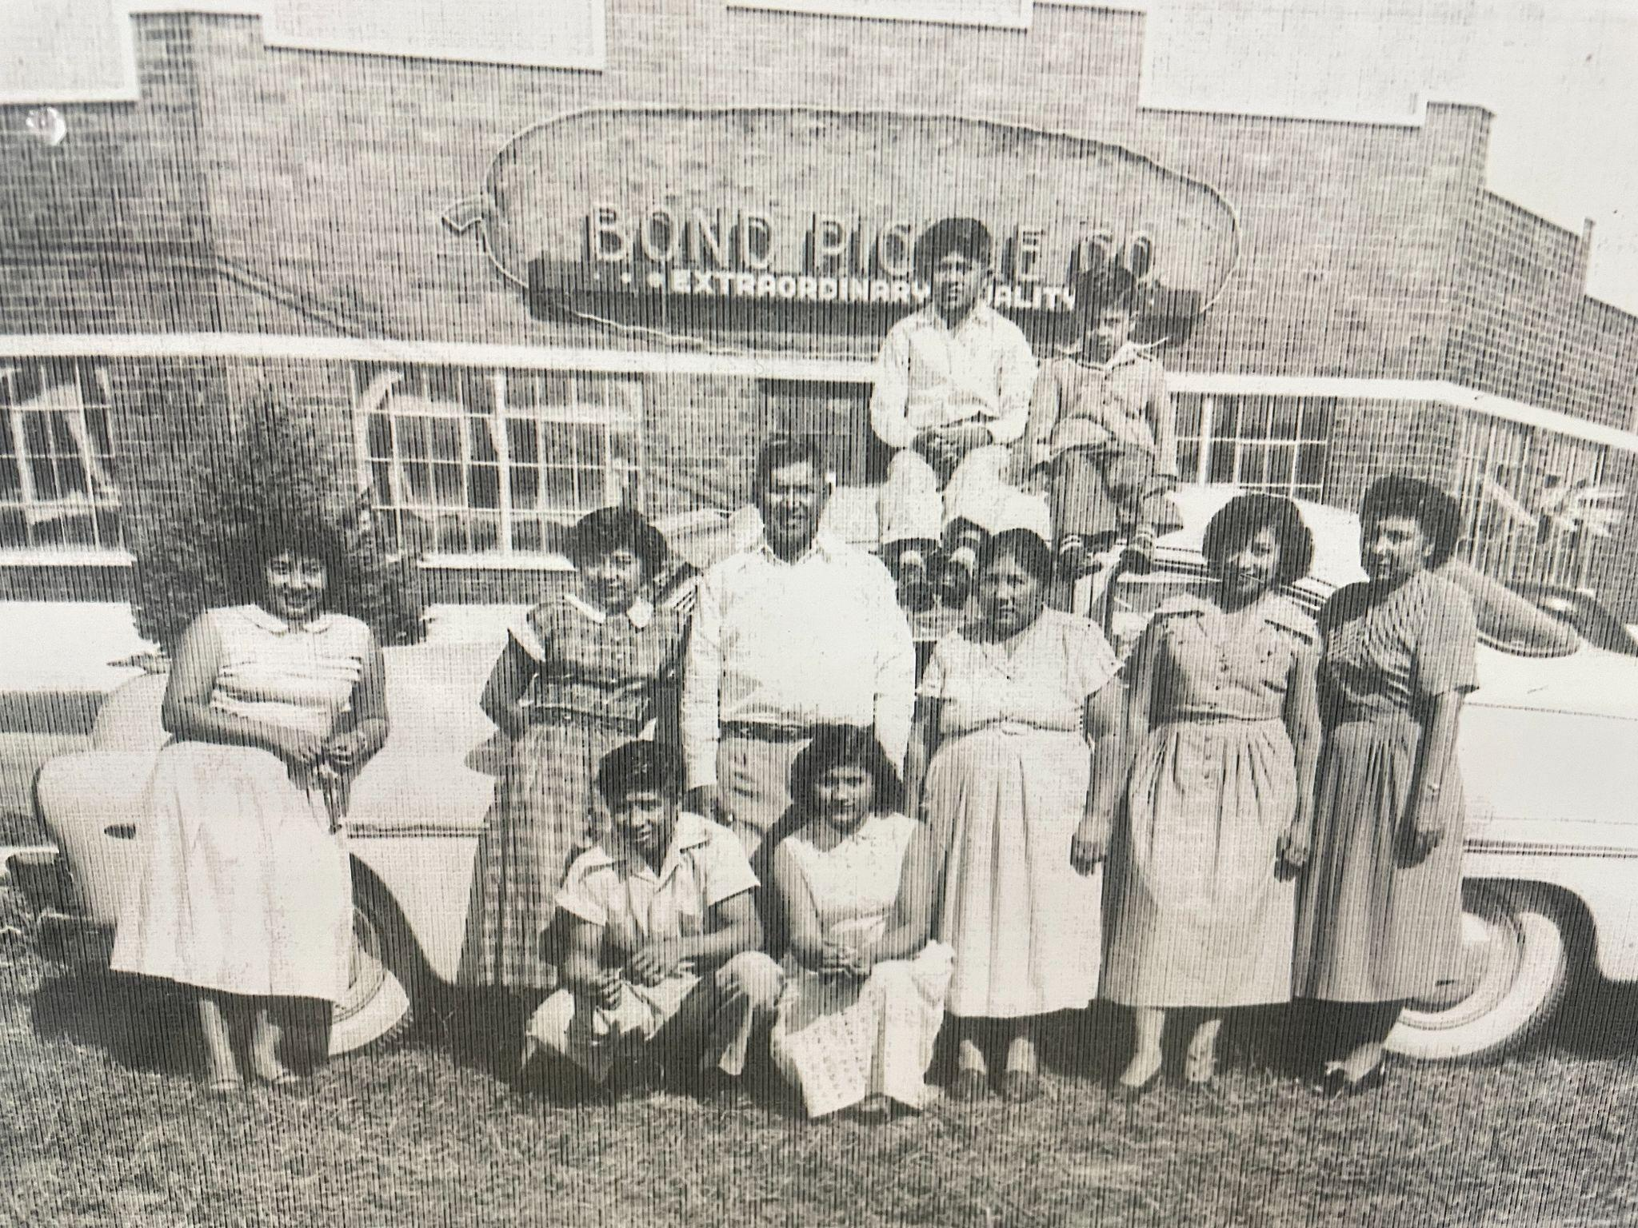
Circa 1952
Notes:
We all have our “why” and what makes us love this work. This is mine. I come from migrant workers. This photo of my family, the young man at the bottom is my dad. This is one of the many journeys the family took to find work. I think about this photo and my dad when working on resources like ABB and Project SMART. I think about how many other Texas migratory students are still living this story and how they could benefit from the resources we are developing and continually updating and enhancing.

Slide 3
Goals
Participants will
understand the purpose and components of each program or resource;
understand how to access each program or resource; and
identify informational materials available to share directly with parents/families.
Notes:
Say:
We have three goals for our time together today.
I’ll provide a brief overview of each resource which explains the purpose and the components of each resource or program. I’ll provide information about how staff and/or parents of migratory children can access the resource.
I also will be sharing some of the informational/marketing materials available to encourage migratory children and parents to use the resource.

Slide 4

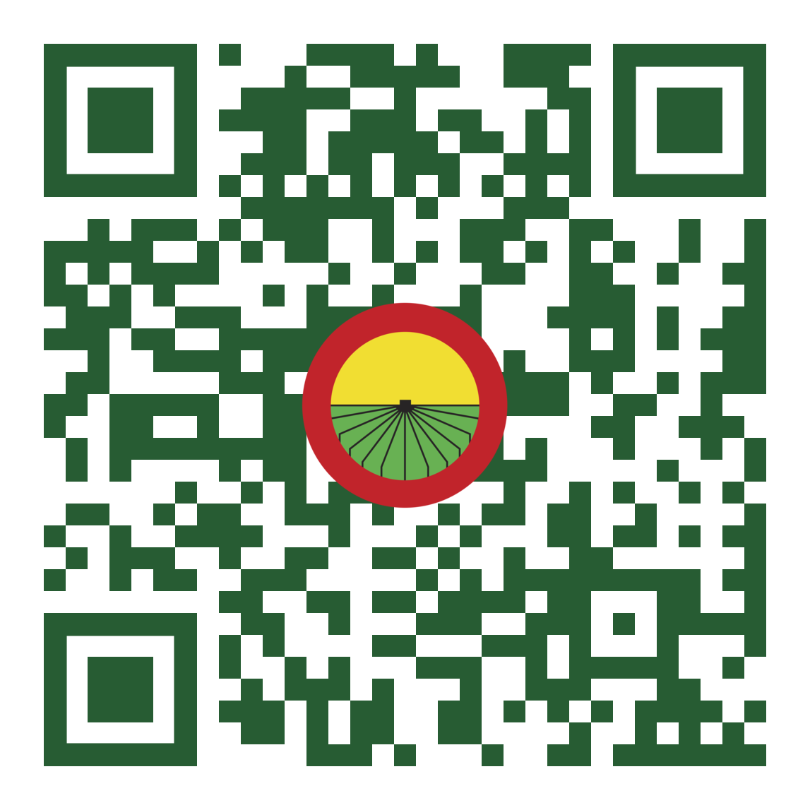
Texas Migrant Education Program (TMEP)
Web Portal
TXMigrant.net
Notes:
The purpose of this portal is to provide educators, MEP staff, and parents of migratory children with access to a suite of resources and tools that support and improve the academic outcomes of migratory children. This portal is constantly evolving with the goal of making it as comprehensive and easily accessible as possible. All of the programs, resources, and tools created specifically for use with Texas migratory children are linked from this portal, as well as, other additional outside resources that support the ultimate goal of improving academic outcomes for migratory children. There is no cost associated with this portal and no account creation is needed. Users simply visit the website to find information and links that support Texas migratory children and their families. We will take a closer look at this portal later in the presentation.
Go to the portal and show them the different places to go on the portal and how they can:
Subscribe
Get to ABB
Get to ProjectSMART

Slide 5



How familiar are you with A Bright Beginning?
ⓘ Start presenting to display the poll results on this slide.
Notes:
Say:
Before we start talking about A Bright Beginning, we want to know how familiar you are with this program. Go to the corner that best describes your experience:
I know the name, but that is it
I know the program, and I have used the program
I could teach someone the program
I don’t know anything about this program

Slide 6

Notes:
Say:
Before you go back to your seat, write down 1 burning question you have about this program and post it on the sign. Once you’ve finished, please have a seat. Thank you for your participation, let’s get into the A Bright Beginning program.

Slide 7

A Bright Beginning is…
A Texas migrant education program
An early literacy program for 3-4 year old children
Purpose
Build early literacy skills of migratory children
Involve parents in the education of their children.
Notes:
Say:
What is the resource?
A Bright Beginning is an early literacy program for three- and four-year old children in the Texas migrant education program.
The purpose of A Bright Beginning is to build the early literacy skills of migratory children and to involve parents in the education of their children.
The goal for children who participate in this program is to develop the pre-reading skills necessary to be successful in kindergarten. The goal for parents who participate in the home-based version of this program is to learn the strategies they need to support their child’s oral language development and to help develop early literacy skills.

Slide 8

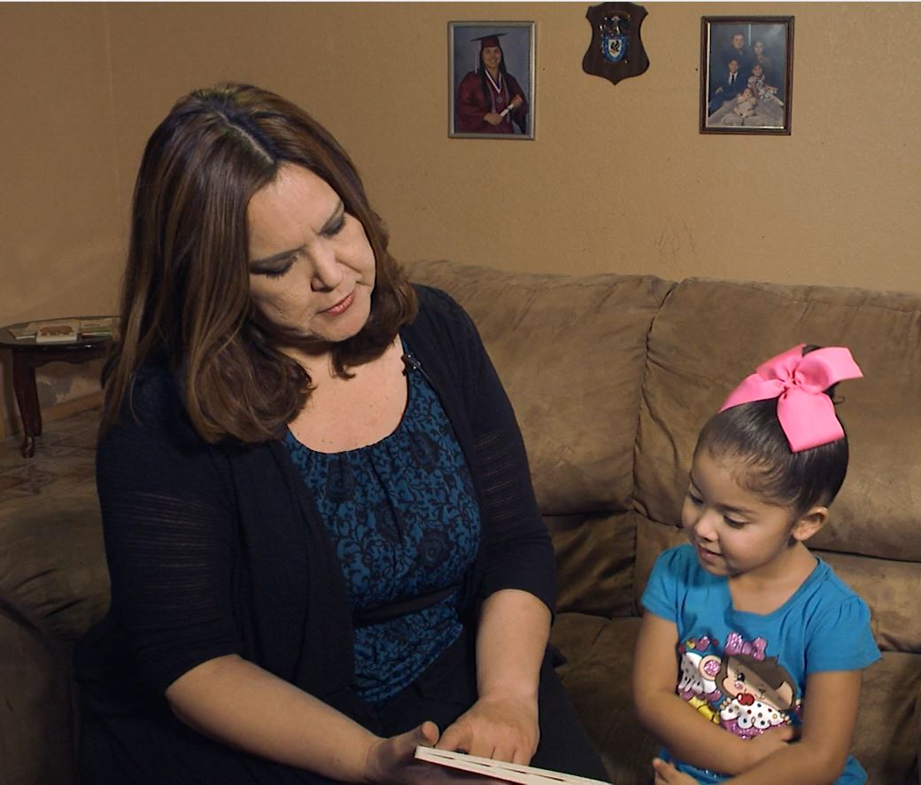
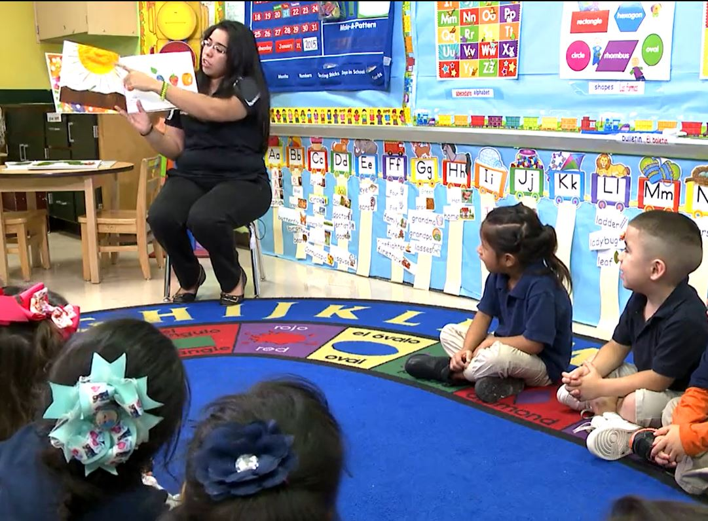

Delivery options
Center-based
Home-based
Notes:
Say:
All components are aligned to the Texas Prekindergarten Guidelines and offered in English and Spanish.
A Bright Beginning can be offered as a center-based program (where multiple children attend at a school or other site). It can also be offered as a home-based program (where instructors teach the lessons in the children’s homes with participation of the parent).
Let’s go to the ABB site so you can see all the components available (Linked on ICON - abrightbeginning.net)
Open the following to show examples:
Educator Home-based tab: My Health Home-based (Revised) Scroll through to just show a few pages of how the unit is set up
Educator Home-based tab: Tip Sheet: HB Developing Oral Language Scroll through to show the length of the tip sheet & play the video link (2:08 min)
Educator Home-based tab: Mini-Lessons: Mathematics: HB Adding to Taking Away Scroll through to show what mini-lessons look like
To transition, click on Educator Center-based and just point out that all of those same components can be found in a similar layout on the center-based page.
Then click
iBooks tab (just to show all the icons there)
Apps tab, then click on the Android icon so it takes you to the landing page with the game icons (just to show all the icons there)
Then click
For Parents tab to point out the tip sheets and videos for parents: Mention that even though the tip sheets are titled the same, the videos included here are different and show parent/child interactions instead of educator/child interactions. To reinforce this, remind the audience that we already viewed the video for educators called “Developing Oral Language” and now we will watch the “Developing Oral Language” video created for parents so they can see how they are different.
Then briefly click on:
Training & Resources
Evaluation Tools (for both of these, just point out that there are many resources available…….but you don’t need to open any of these unless anyone requests you to…..)
Last, click on:
Online Courses (mention that there are 7 courses available to support instructors that can be taken anytime after accessing the portal)
Ask if there is any other file or tool on this portal that they would like you to open so they can view it.

Slide 9
How do I get started?
MEP staff in each school district
identify and recruit migratory children, ages 3-5
determine which children are being served by a school-readiness program, such as pre-kindergarten or Head Start
offer A Bright Beginning services to migratory children who are NOT being served by another school-readiness program.
Notes:
The A Bright Beginning program is a school readiness program provided to migratory children who are not currently being served by another school-readiness program, since MEP-funded services must support the unmet educational needs of migratory children.
A full-day-school-readiness program will likely meet the educational needs and provide the maximum benefit to children in terms of preparing them for kindergarten, so those programs, like pre-K or Head Start should be the priority whenever available.
When migratory children ages 3-5 are unable to be served by another of these school-readiness programs, for whatever the reason, then the A Bright Beginning program can be offered to help meet this need.

Slide 10

How familiar are you with Project SMART?
Notes:
Say:
Before we start talking about Project SMART, we want to know how familiar you are with this program. Go to the corner that best describes your experience:
I know the name, but that is it
I know the program, and I have used the program
I could teach someone the program
I don’t know anything about this program

Slide 11

Notes:
Say:
Before you go back to your seat, write down 1 burning question you have about this program and post it on the sign. Once you’ve finished, please have a seat. Thank you for your participation, let’s get into the Project SMART
program.

Slide 12
Project SMART
Purpose
Texas summer math program
To strengthen the math skills of migrant students who have completed grades K-8.
Improve the math skills of migratory children through research-based instruction.
Notes:
Say:
What is the resource?
Project SMART is a Texas summer math program designed to strengthen the math skills of migratory students who have completed grades K-8.
(click)
What is the purpose of the resource?
The purpose of Project SMART is to improve the math skills of migratory children through research-based instruction. The program focuses primarily on math skills, and also includes literature lessons and, in the school-based setting, STEM, or Science, Technology, Engineering, and Math, projects.
Each participating student completes a mathematics pre-assessment on the first day of the program, and a mathematics post-assessment on the last day, in order to determine the specific gains made through participation in the program.

Slide 13
The components of this program
Five grade bands
K 1 and 2 3 and 4 5 and 6 7 and 8
Four units, 3 lessons in each
Center-based
Math lessons
Family Game
Spiral Review
Fun with Fractions
Literature lessons
STEM activities
Home-based
Math lessons
Family Game
All other components are available to use as time permits.
Notes:
Say: The program is organized into five grade bands….
Each grade band has four units of instruction… with 3 math lessons in each unit.
Let’s visit the site so you can see all the resources available
Let’s go to the Project SMART site so you can see all the components and how they are organized (Linked on - projectsmart.net)
Open the following to show examples:
Center-based Curriculum tab: Kinder Unit 1 Scroll through to just show a few pages of how the unit is set up
Center-based Curriculum tab: Kinder Handouts & Cardstock Click to show the Student Handouts & Teacher Handouts ….you can explain that this allows the instructor to print all copies at once or create a student workbook, etc.
Center-based Curriculum tab: Kinder Grade Band Overview: Math Lessons Preview this document to show them what these overviews look like
To transition, you can say that the Home-based Curriculum page is organized in the same way. No need to click on it.
Then click
Assessments tab to point out that all pre- and post-assessments can be found here
Then click on:
Videos: Point out that there are Student Lesson videos and Teacher Instructional videos. The Student Lesson videos are designed to be played directly for students. Play Grades 7-8 Unit 1 Student Lesson 1 video……(just the first 2 minutes so they get the idea)
Explain that the teacher instructional videos are a bit less formal as they are designed to be viewed by any teachers needing support before teaching any of the lessons. Here’s an example: Play Grades 7-8 Unit 1 Family Game video (just the first 2 minutes so they get the idea)
Say: You can also find many additional resources including How-To direction sheets, surveys, and item analysis information. (Briefly click on each of the following tabs:)
Training Resources
Additional Resources
Surveys
Item Analysis
Last, click on:
Online PD (mention that there are 2 courses available to support instructors that can be taken anytime after accessing the portal, as well as other videos, modules, and a link to a collaborative forum for instructors.
Ask if there is any other file or tool on this portal that they would like you to open so they can view it.

Slide 14
How do migratory children participate in the program?
MEP staff in each school district:
identify and recruit migratory children, grades K-8;
determine whether a Project SMART program may be offered in their region; and
offer the Project SMART program to parents of children in the designated grade band(s)
Notes:
Say: How do migratory children participate in this program?
MEP staff in each school district
identify and recruit migratory children, grades K-8;
determine whether a Project SMART program may be offered in their region. The determining factors may be
whether there are enough migratory children remaining in the district over the summer to be served
whether the students who will be in the district over the summer are going to be enrolled in the district’s summer school program, since the Project SMART summer program must be supplemental to any required district program. Another consideration is
whether the district has qualified staff to teach each grade band (K, 1-2, 3-4, etc).
Once the district determines they can offer a Project SMART program because they have students to serve and staff to deliver the instruction, the district then will
offer the Project SMART program to parents of children in the designated grade band(s) for the upcoming summer.
Are there any questions about the Project SMART summer math program?

Slide 15
Review Materials
What do you notice about…
the site?
the lessons?
the support?
Notes:
Say:
We would like to give you an opportunity to review the wide variety of materials and resources within these programs. We have an iPad so you can explore the portal site that houses these materials and some samples of the units/lessons included.
Please go to whichever program you would like to explore. While you are there, scan over the materials and think about the things you notice within the programs.
Activity:
Split people into two groups (like which one they think they need)
Have them scan over the materials and then report out what they see
Then after they report, you can add to what they missed
Materials Needed:
ABB Binders
Center-based and home-based
iPad with it logged in
ProjectSMART
Build Project SMART maybe K and 5-6 grade bands
iPad logged in to the

Slide 16

Texas Migrant Education Program
Resources for Migratory Children
Informational Materials
available at
the TMEP Portal
Notes:
Say:
Now that we’ve provided you with information about A Bright Beginning and Project SMART, let’s talk about marketing. One of our challenges has been figuring out the best way to advertise and market these programs so that migratory families know that they are available; we are always looking for ways to ensure that ALL eligible children and their families are aware of these programs, especially when they are being offered for free in their communities.
Pause to ask this question and ask for verbal and chat feedback: What marketing and advertising efforts have you found successful in sharing these resources with migratory families?
**Hopefully you responded to the poll question about the most effective ways you have found to share important information with your migratory families. This could help in our efforts to market these resources.
In a moment, we are going to take an in-depth look at everything available on the TMEP portal. For now, we want to show you the Migrant Education Marketing Materials webpage and where the marketing resources are housed. We will show you the specifics of how to access this webpage when we get into the portal in a few minutes.
To market these resources, there are brochures available in both English and Spanish that can be printed by MEP staff to be shared with parents of eligible children, or sent via email or text. This brochure provides information about Project SMART and A Bright Beginning and it also includes information about the Education Resources portal. SHOW THE B&W brochure.
*click Brochure to show
If you would like more information about the Education Resources portal, you can attend any of our sessions titled: Digital Resources to Support Migratory Parents and Families. The Education Resources portal is one of several resources shared during those sessions.
We have also developed several short videos in both English and Spanish that market the programs shared with you today. Our hope is that ESC and district MEP staff will share links to the videos with their parents.
The videos for A Bright Beginning and Project SMART are available in both English and Spanish. They are also specific to the type of program being offered in your area. Some programs are delivered in a school or other physical location where multiple children attend at the same time and this is what is called: Center-based. Other programs are delivered by sending an instructor to the child’s home which is considered Home-based. The type of program offered in a district or community depends on the specific needs in that area, the number of children being serviced, availability of instructors, etc.
The different types of marketing videos were created so that you are able to show parents and families the video that represents the type of instruction offered in their district.
Here’s an example of the marketing video for the A Bright Beginning for Home-based programs. (video is about 2 ½ minutes)
https://tetnvideo.hosted.panopto.com/Panopto/Pages/Viewer.aspx?id=7be19ae2-3431-4bb7-93c4-ae6a018458dc

Slide 17
Next Steps
How do I get access to these programs?
Contact your ESC MEP Staff
If you have any other questions, please contact Sherri Nunneley
sherri.nunneley@esc20.net
Notes:
Educators who will implement these resources with migratory students will need to be trained by their respective ESC MEP staff on how to utilize and access the resources before they can actually implement these programs. During these trainings, an access code is provided that allows educators to log in to the portals where all of the resources are housed. There is no license or subscription needed.
Although the curriculum, lessons, and other resources associated with these programs are available for free, there are some initial costs associated with both the ABB and PS programs: there are books to purchase that correlate with the lessons, and materials to print. Other costs associated with ABB and PS include staff time: Districts will need to hire teachers, paraprofessionals, or tutors to deliver the instruction of the ABB or Project SMART program.

Slide 18
Thank You!
Idalia Ibañez
Director – MEP/USCO/Title V, Part A
Federal Program Compliance Division
Texas Education Agency
migrant.ed@tea.texas.gov
Myra Faris
Research and Development Specialist
Federal, State, and Local Initiatives
Education Service Center, Region 20
tea.mepgrants@esc20.net
Notes:
Say:
That concludes our session for today. We appreciate the time you have given us to share this information on the programs and resources being developed for migratory children and parents.
We will remain here in our meeting for a few minutes, in case anyone has any questions or comments. Thank you!

Slide 19
An Overview of the Curriculum Initiative
Notes:
Ending Slide

Slide 20
Print Slides 21-32 in color on cardstock

Slide 21
An Overview of the Curriculum Initiative
Just an overview of the programs.

Slide 22
An Overview of the Curriculum Initiative
I’d like to know more about the components of the programs.

Slide 23
An Overview of the Curriculum Initiative
I would like to check my emails quietly in the back.

Slide 24
An Overview of the Curriculum Initiative
How I can get the word out about these programs?

Slide 25
I know the name of the programs, but that’s it.
ⓘ Start presenting to display the poll results on this slide.

Slide 26
I know the program and I have used the program.
ⓘ Start presenting to display the poll results on this slide.

Slide 27
I could teach someone about the program.
ⓘ Start presenting to display the poll results on this slide.

Slide 28
I don’t know anything about this program.
ⓘ Start presenting to display the poll results on this slide.

Slide 29
I know the name of the programs, but that’s it.

Slide 30
I know the program and I have used the program.

Slide 31
I could teach someone about the program.

Slide 32
I don’t know anything about this program.

