Slide 1
Digital Resources to Support Migratory Parents and Families
Notes:
Say:
TEA: Good afternoon and welcome! Introductions….
*Idalia will introduce herself and her role at TEA. Then say…
“All of the resources we are going to share with you today were developed as part of the TEA Capacity Building Initiative Grant. We are very excited to share these resources with MEP staff, educators, and families. With that, I would like to introduce our presenter for this session, Jeremy Poston.”
I’m Jeremy Poston, a specialist on the federal, state, and local initiatives team at Education Service Center, Region 20. Our team works exclusively in support of grant initiatives from the Texas Education Agency.
Before we begin the presentation, we just want to clarify the intended audience for today’s session. The resources and programs that will be shared are available to MEP staff who support migratory students and their families. If you do not work directly with this population, you will not have access to many of the resources we are going to share.
*****Ask who in the room is a parent and who is a MEP Staff member to tailor how the presentation should be done

Slide 2
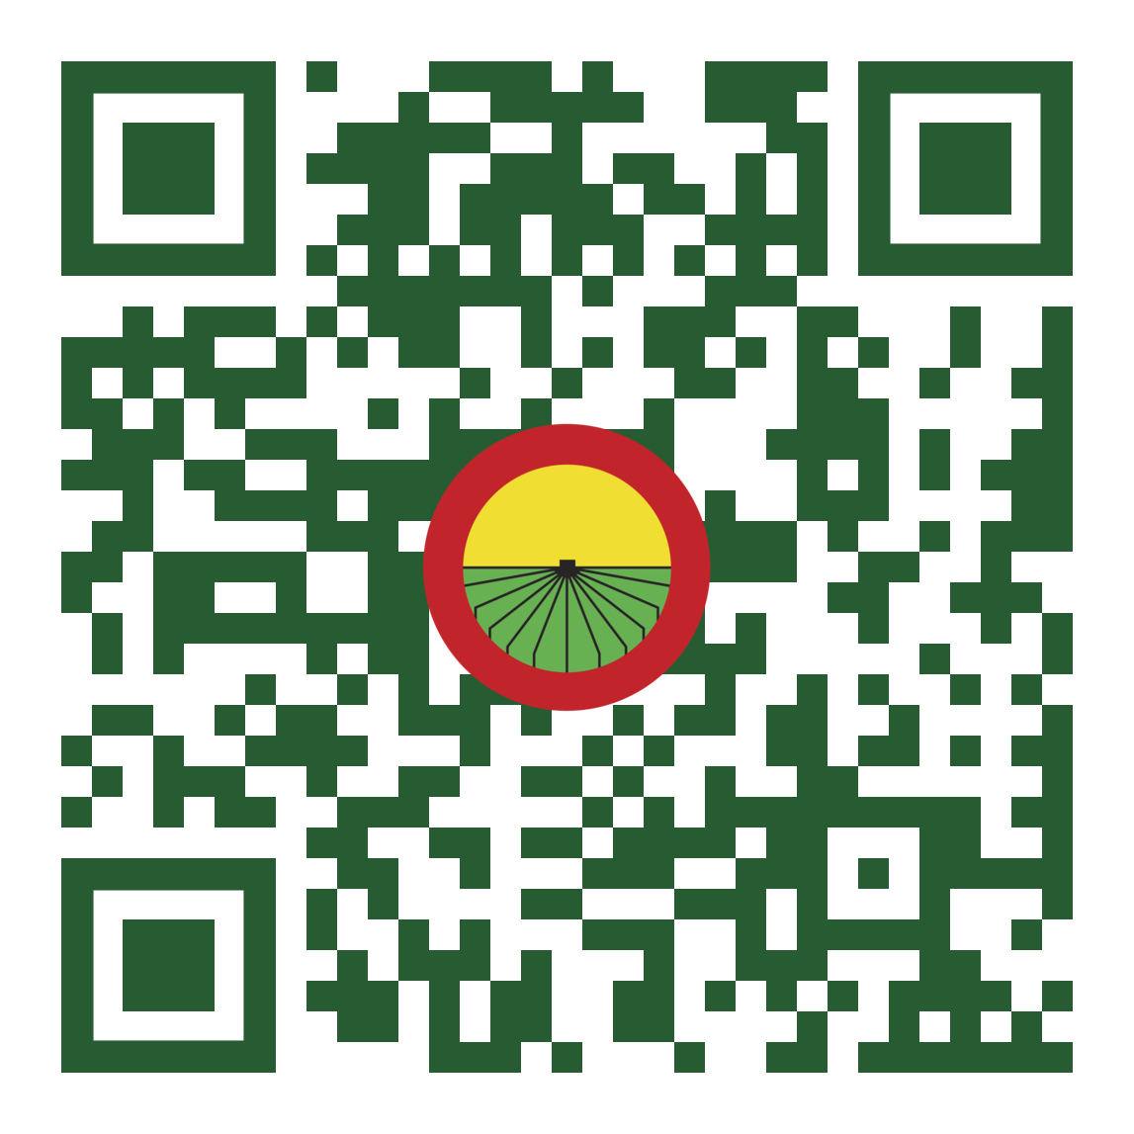
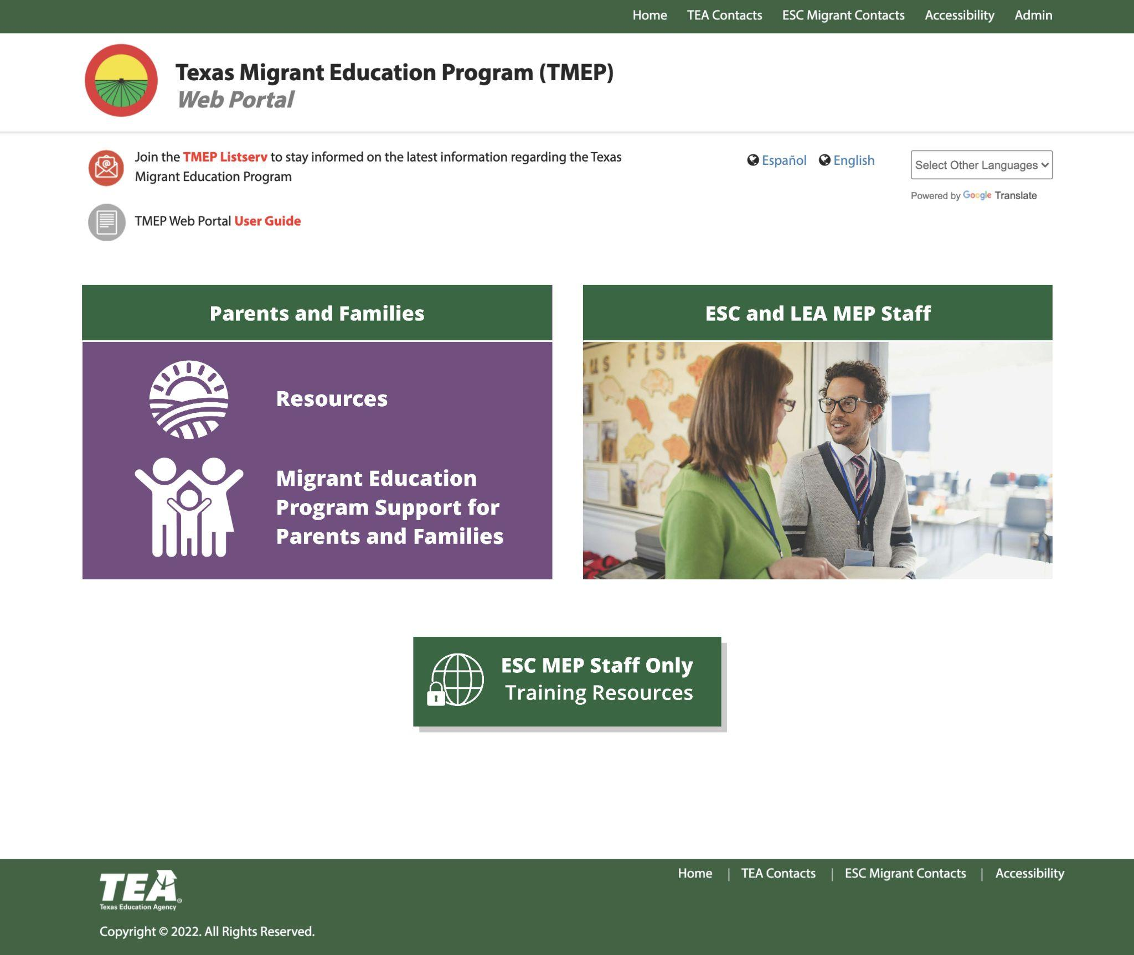
Redesigned TMEP Web Portal: txmigrant.net
Notes:
Say:
We will start with the TMEP portal. This portal is a platform for accessing all the resources we will share today along with many other resources.
We encourage you to visit the site now. We will be showing the images on the screen but you can also follow along by scanning the QR code or accessing the site directly at txmigrant.net.
This website has been in existence for several years but it has recently been redesigned. We would like to take some time now to show how it is organized and the materials currently available.
TMEP Portal: https://www.txmigrant.net/

Slide 3
What is this resource?
This resource is a portal with materials and links to other relevant sites available for all staff and parents who support migratory children.
What is the purpose of this resource?
The purpose of the portal is to provide easy access to a wide variety of materials and information intended to meet the needs of Texas migratory children and families.
Notes:
Say:
What is this resource?
This resource is actually a resource portal that is continuously being upgraded and enhanced with new materials and links organized in a manner that is user-friendly.
(click)
What is the purpose of the resource?
The purpose of the resource portal is to provide easy access to a wide variety of materials. We really want this to be a one-stop shop where MEP staff and parents and families of migratory children can readily and easily find any information or resources they might need.
**IF you are accessing the site, we encourage you to bookmark it so you can easily return

Slide 4
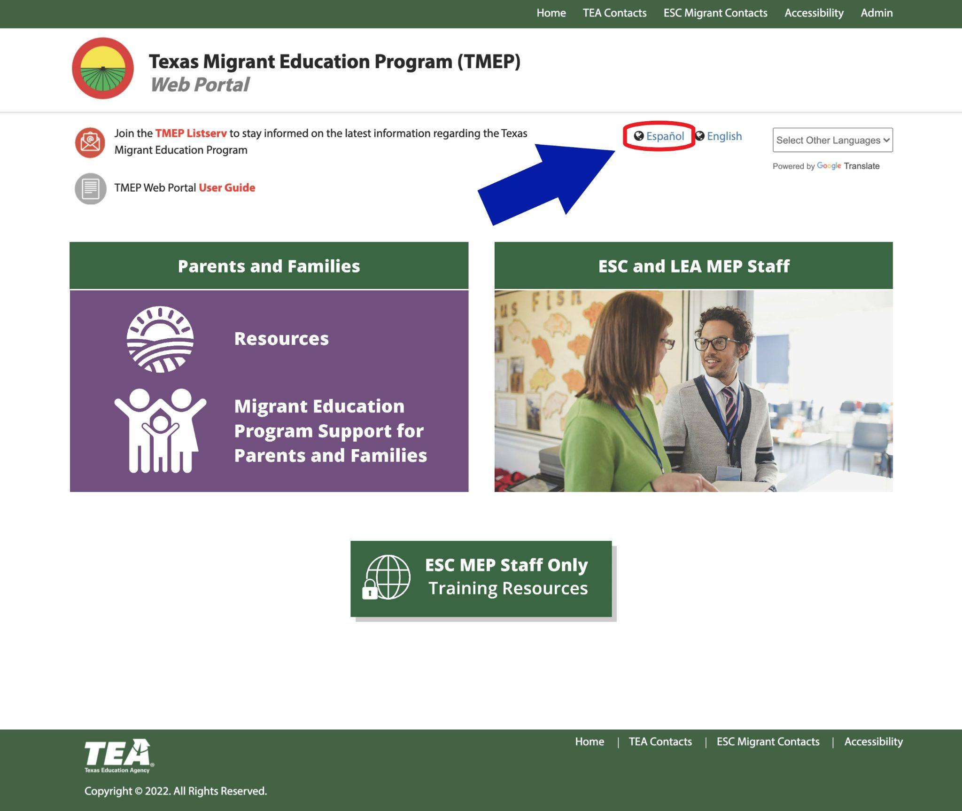
Notes:
Say:
When you arrive at the site, there are several options on the home page, which we will walk you through right now.
It is important to note that the language can be changed. Users are able to select Espanol to view the content on each page in Spanish.
(click)
click to advance

Slide 5
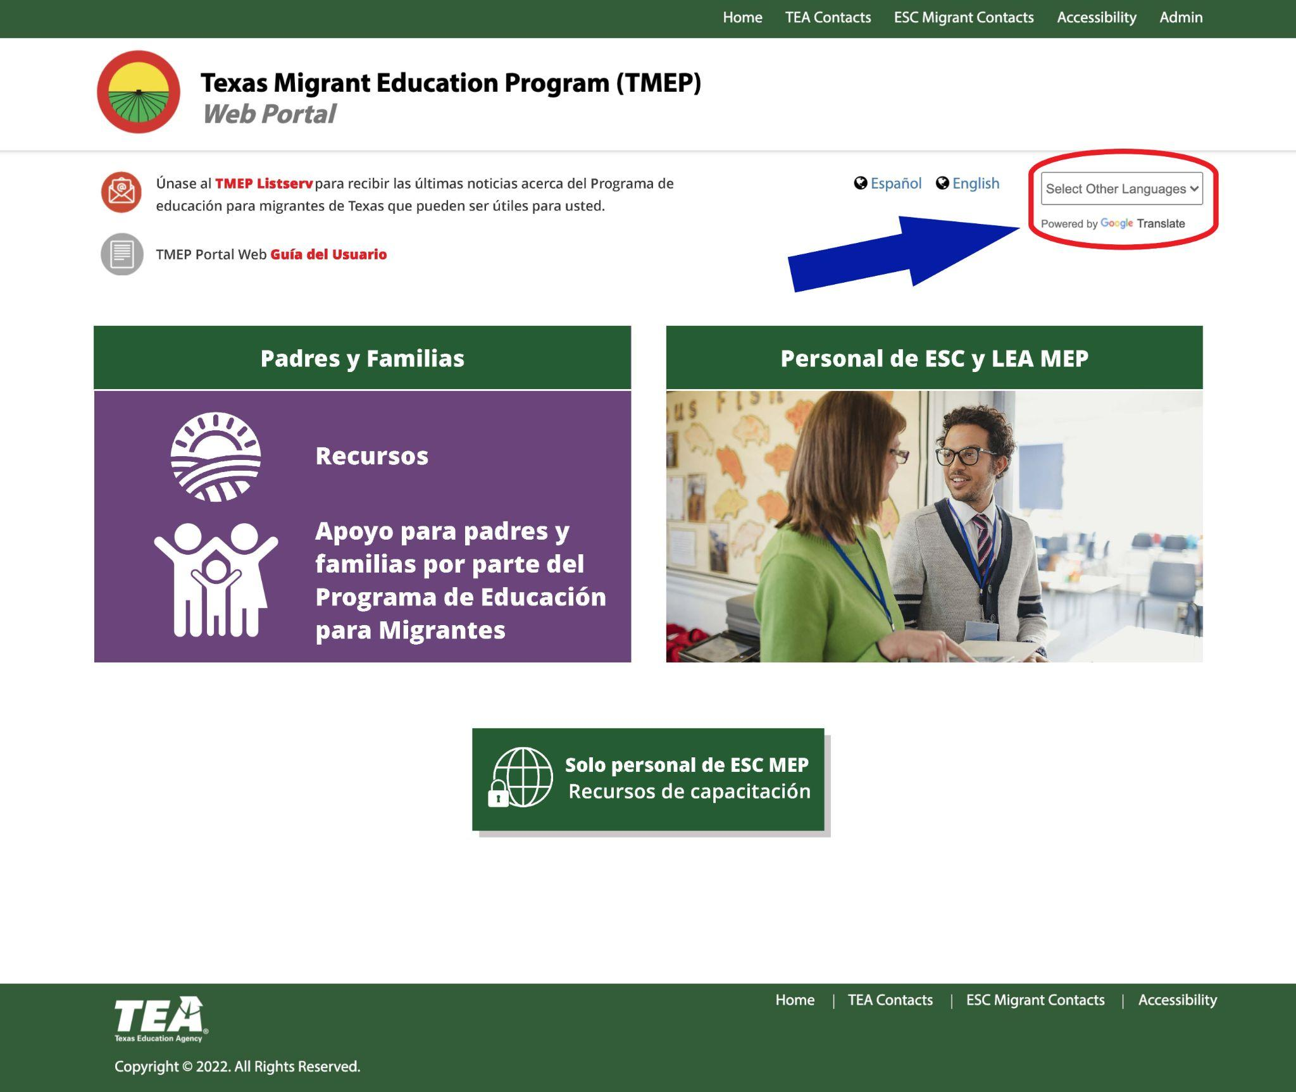
Notes:
Say:
Selecting this will translate all labels and content on the website as shown here.
Parents who need translations into other languages have this same option by clicking here (click) to Select other languages using Google Translate. (click)

Slide 6
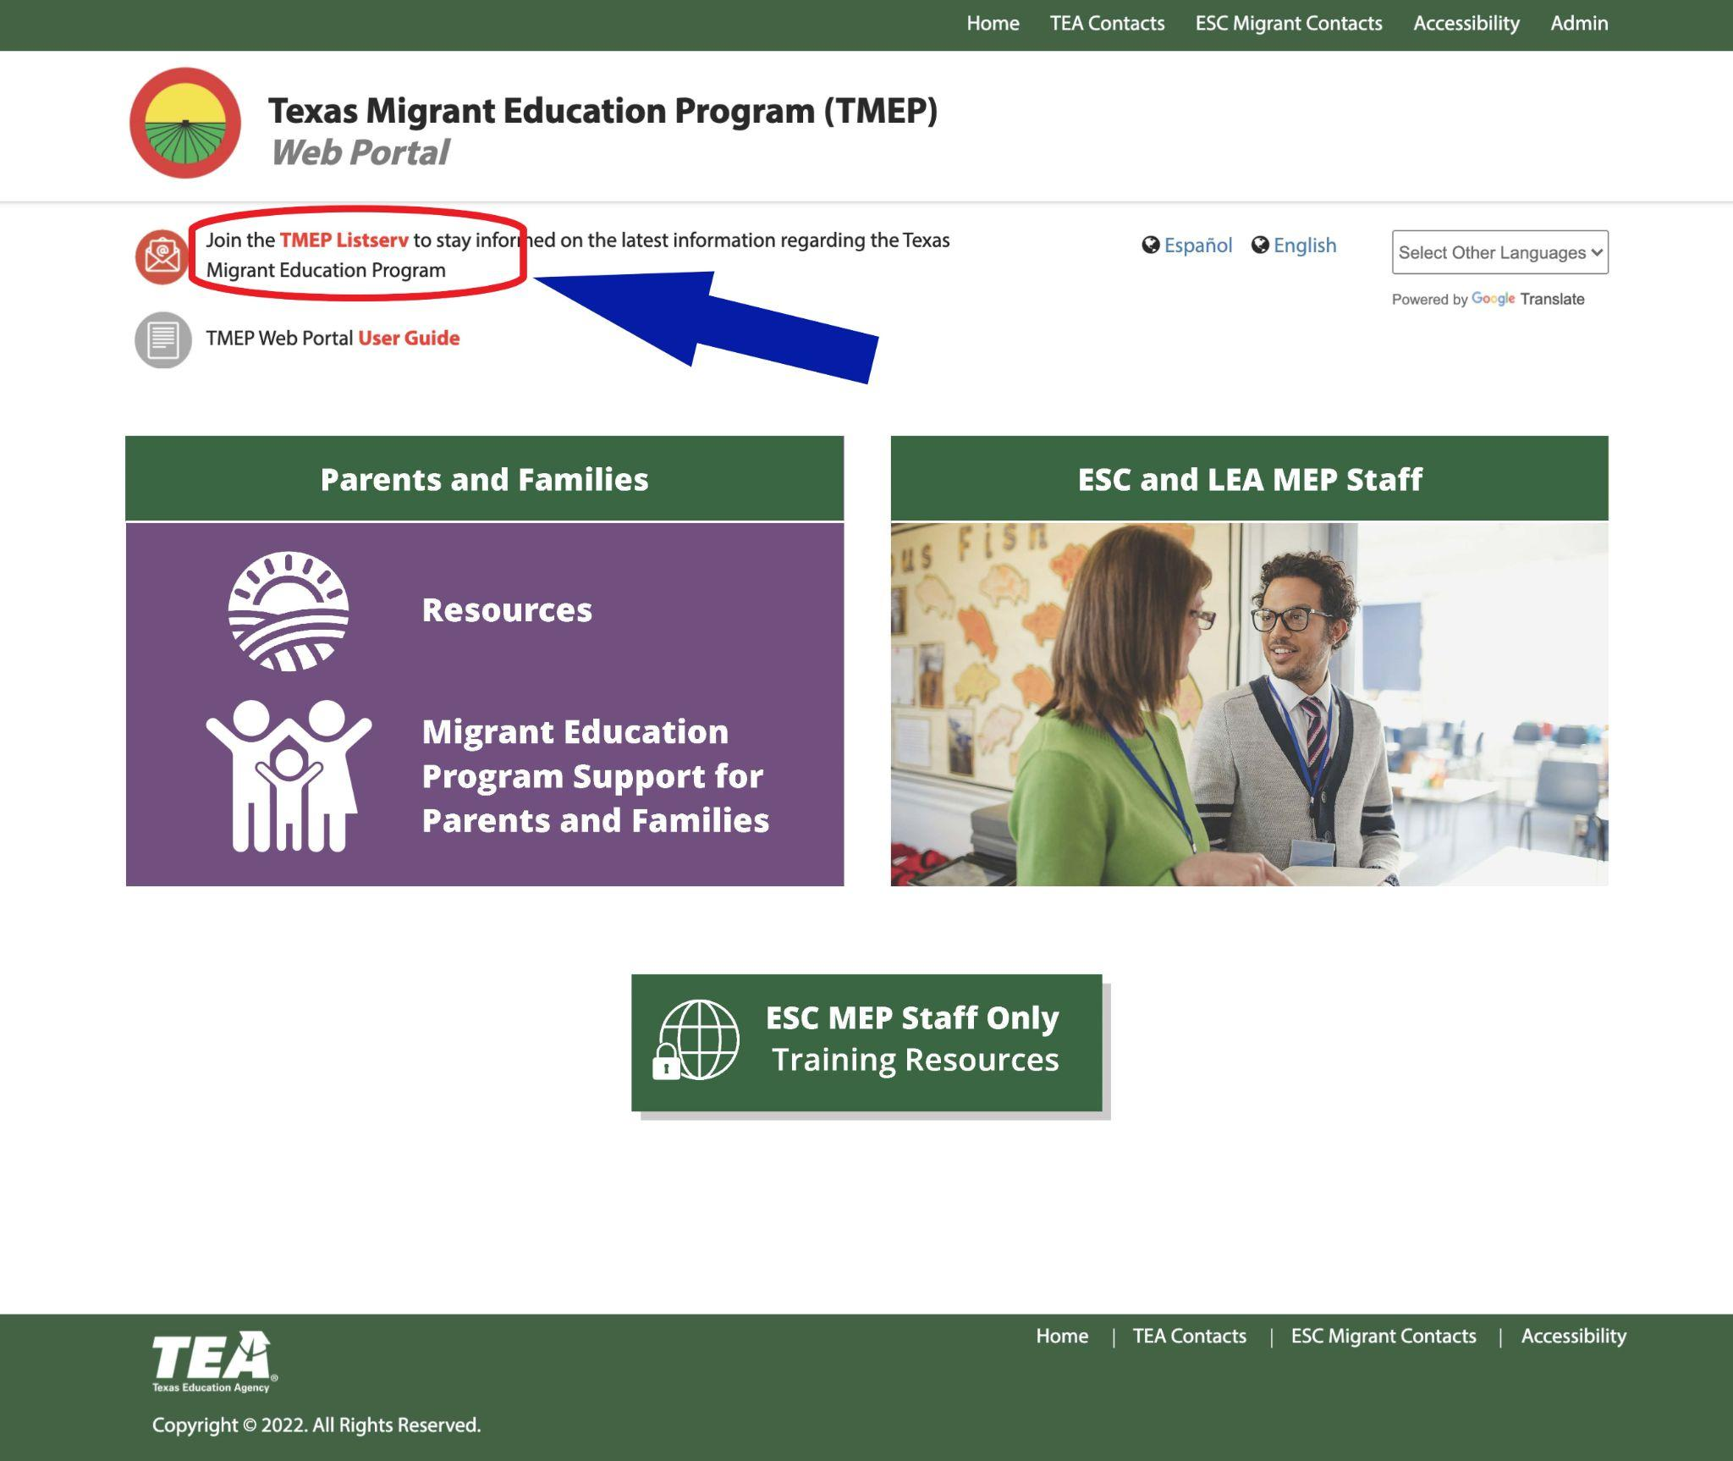
Notes:
Also all users, including parents, are encouraged to join the TMEP Listserv by clicking the link at the top.
(click)
In fact, we’d like to encourage everyone who may be accessing the site along with us to take a minute to do this now. You will only need to enter an email address, select your role, and the region of Texas that you belong to. Make sure to encourage any migratory parents and families that you know to join the listserv as well.
Before we access the parent side of the portal, we’d also like to highlight what’s available by clicking the different contacts in the top and bottom ribbons.
(advance slide)

Slide 7
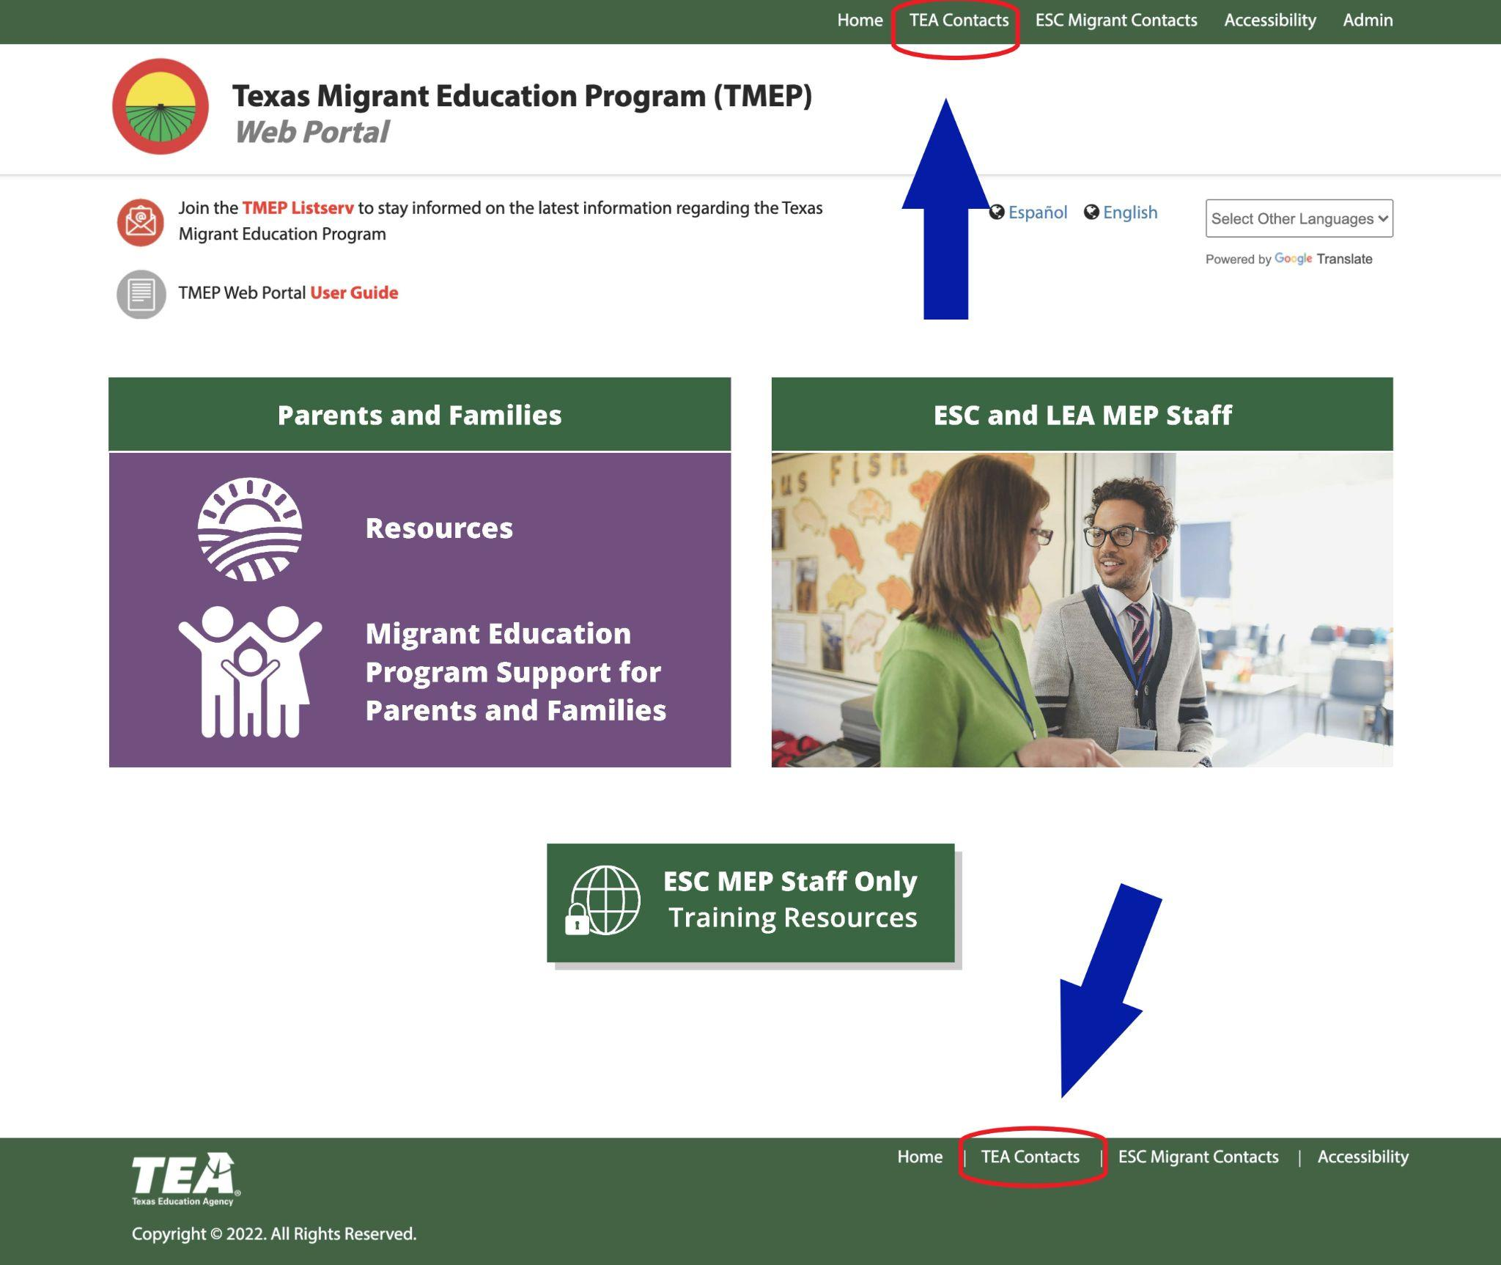
Notes:
Say:
Selecting the TEA Contacts from the ribbon at either the top or bottom will provide (click)

Slide 8
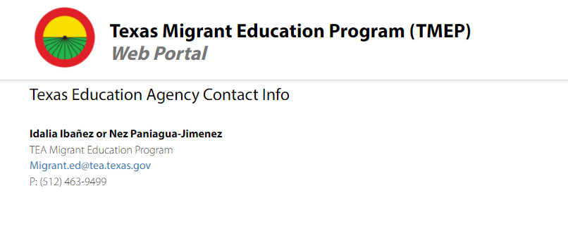
Notes:
Say: an email address and phone number for contacting current TEA Migrant Education Program staff.

Slide 9
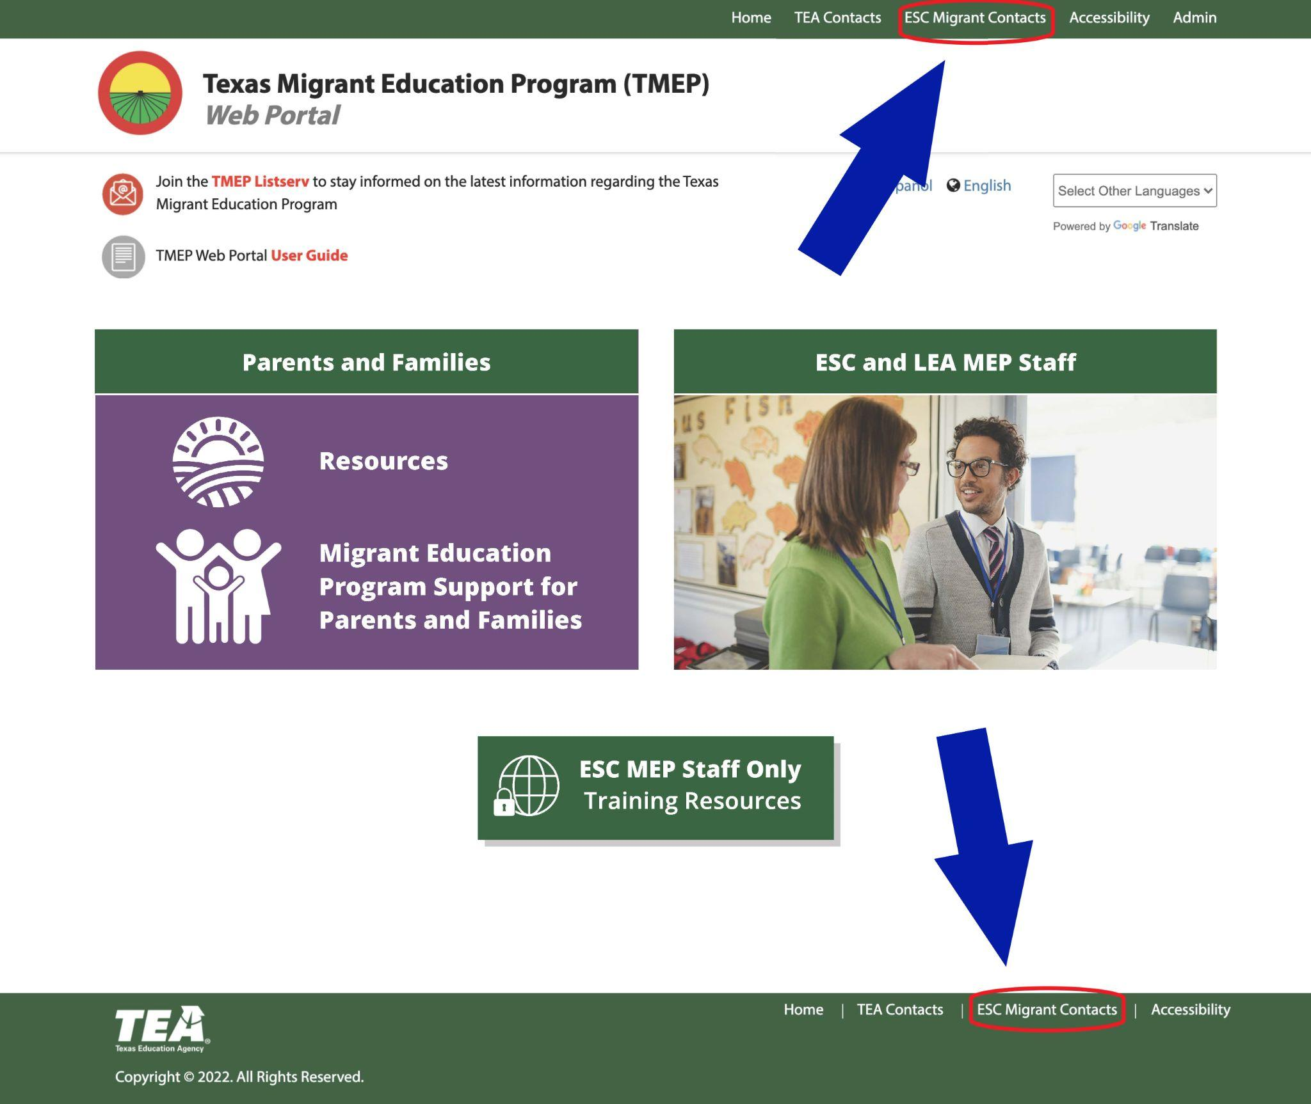
Notes:
Say:
Selecting the ESC Migrant Contacts from the ribbon at either the top or bottom (click)

Slide 10
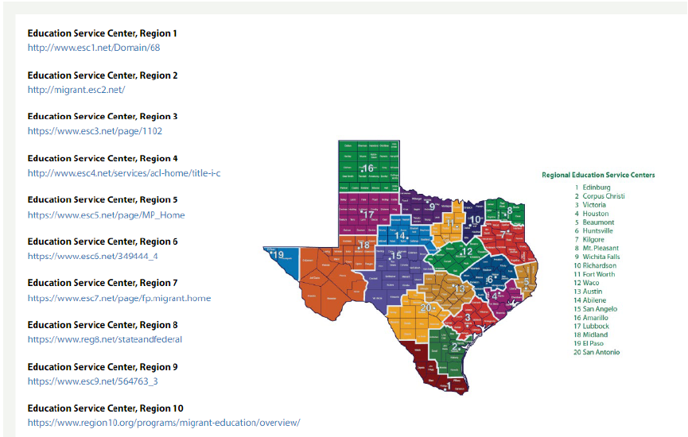
Notes:
Say:
will provide a list of all 20 Education Service Center regions with a link to each of their MEP home pages. If you are unsure which region to contact, the color coded map allows you to find your location and identify the region.
Say:
Selecting Accessibility from the ribbon at either the top or bottom (click)

Slide 11
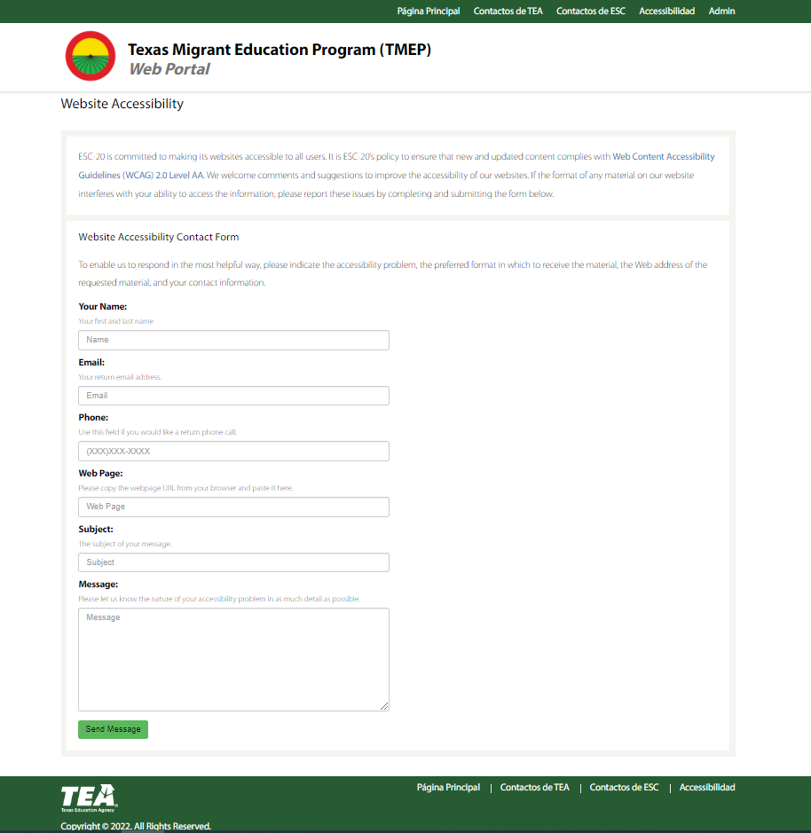
Notes:
Say:
will provide a contact form in which users can offer comments and suggestions about ways to improve the accessibility of the site.

Slide 12
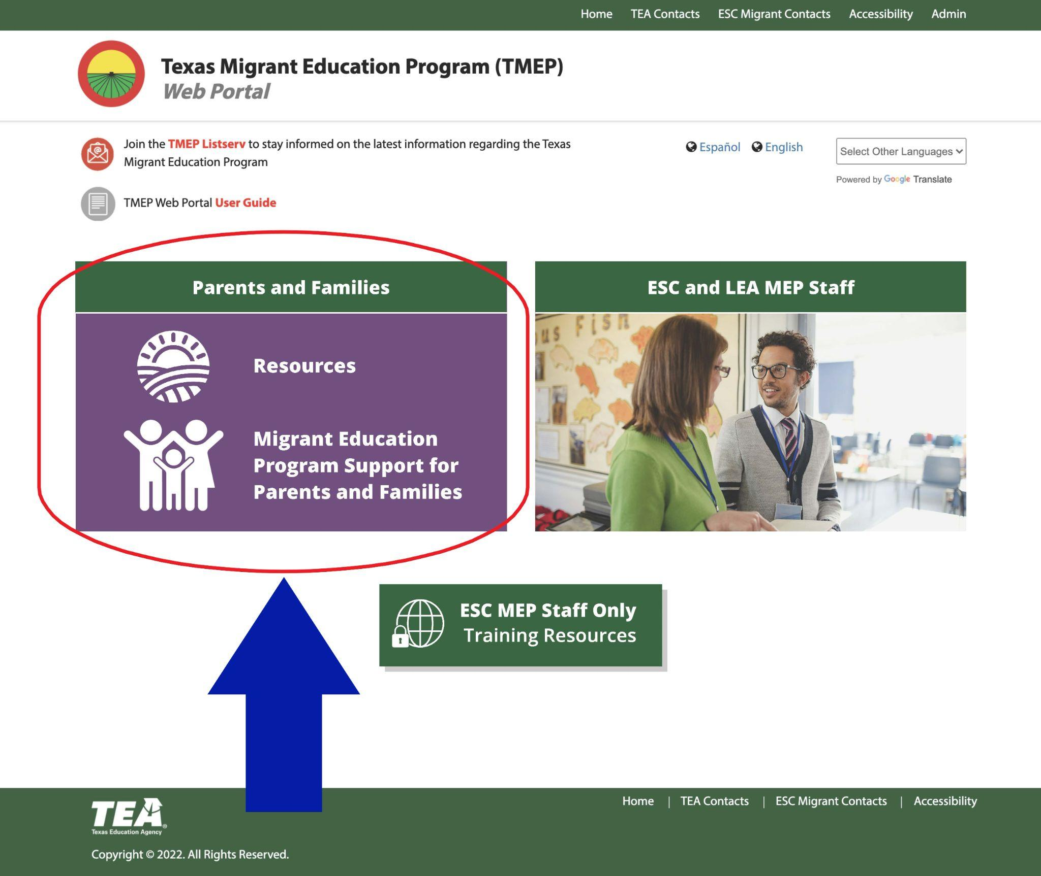
Notes:
Say:
Now let’s take a look at the Parents side of the portal.
On the current TMEP homepage, parents can access various tools and links that provide support by clicking Resources or parents can access detailed information about the Migrant Education Program and answers to any questions they might have by clicking “Migrant Education Program Support for Parents and Families.”
https://www.txmigrant.net/
Click “Resources” to go to that part of the site and point out:
**The scrolling banner that can be clicked and link you to the highlighted information regarding programs that can benefit migratory students and families.
**Below the banner are several icons. Some of the icons are “Live,” meaning there is content the user is directed to when they click on it. The icons that are greyed out are still under development.
Lets Go to the Recognition and Scholarship Opportunities for Migratory Students section of the portal. This section of the portal provides up to date scholarship opportunities for migratory students. Scrolling down you will notice the current scholarships available. **Click on any scholarship** By clicking on the scholarship you will see a brief description of the scholarship opportunity, clicking on the scholarship information will lead you directly to the page that provides all of the detailed information necessary for applying.
Lastly Notice the Contact Us icon: Parents will want to click this icon if they have any feedback or question regarding the content on the site. This will lead them to the general feedback survey. Parents can also find the General Feedback Survey linked at the top of the page as well.
Any questions about the Resources section on the Parents side of the portal?

Slide 13
Notes:
Say:
Now let’s take a look at the other link on the Parents side of the portal.
Click “Migrant Education Program Support for Parents and Families” to go to that part of the site and point out:
**When you click here, you will be directed to the Migrant Education Program Support for Parents and Families portal. You will find information about how students and families qualify for the MEP and how the program is funded.
Scroll down to the 2 videos side by side.
**These two videos share tips to help ensure smooth transitions during migratory moves. These tips are also included in a checklist. (point out linked PDFs)
**More specific topics related to the type of support the MEP can provide students and families are included at the bottom of the home page. These topics include:
Academic support for students in school
Support for out-of-school youth
Assistance and preparation for after graduation
Advocacy support, and
Technology support
Many resources are shared throughout the portal. The last button at the bottom of the home page directs you to a page that compiles all of these resources into one place, creating a place to quickly find a specific resource you may be searching for.
(Click on the first topic, “How Can the MEP Support My Child in Grades Kindergarten through Grade 12” and review some of the different features of the page.)
**We encourage you to visit this site often and share it with other migratory families you meet. Information is available to help you with the changing needs of your family as they grow.
Any questions about the Support section on the Parents side of the portal?

Slide 14
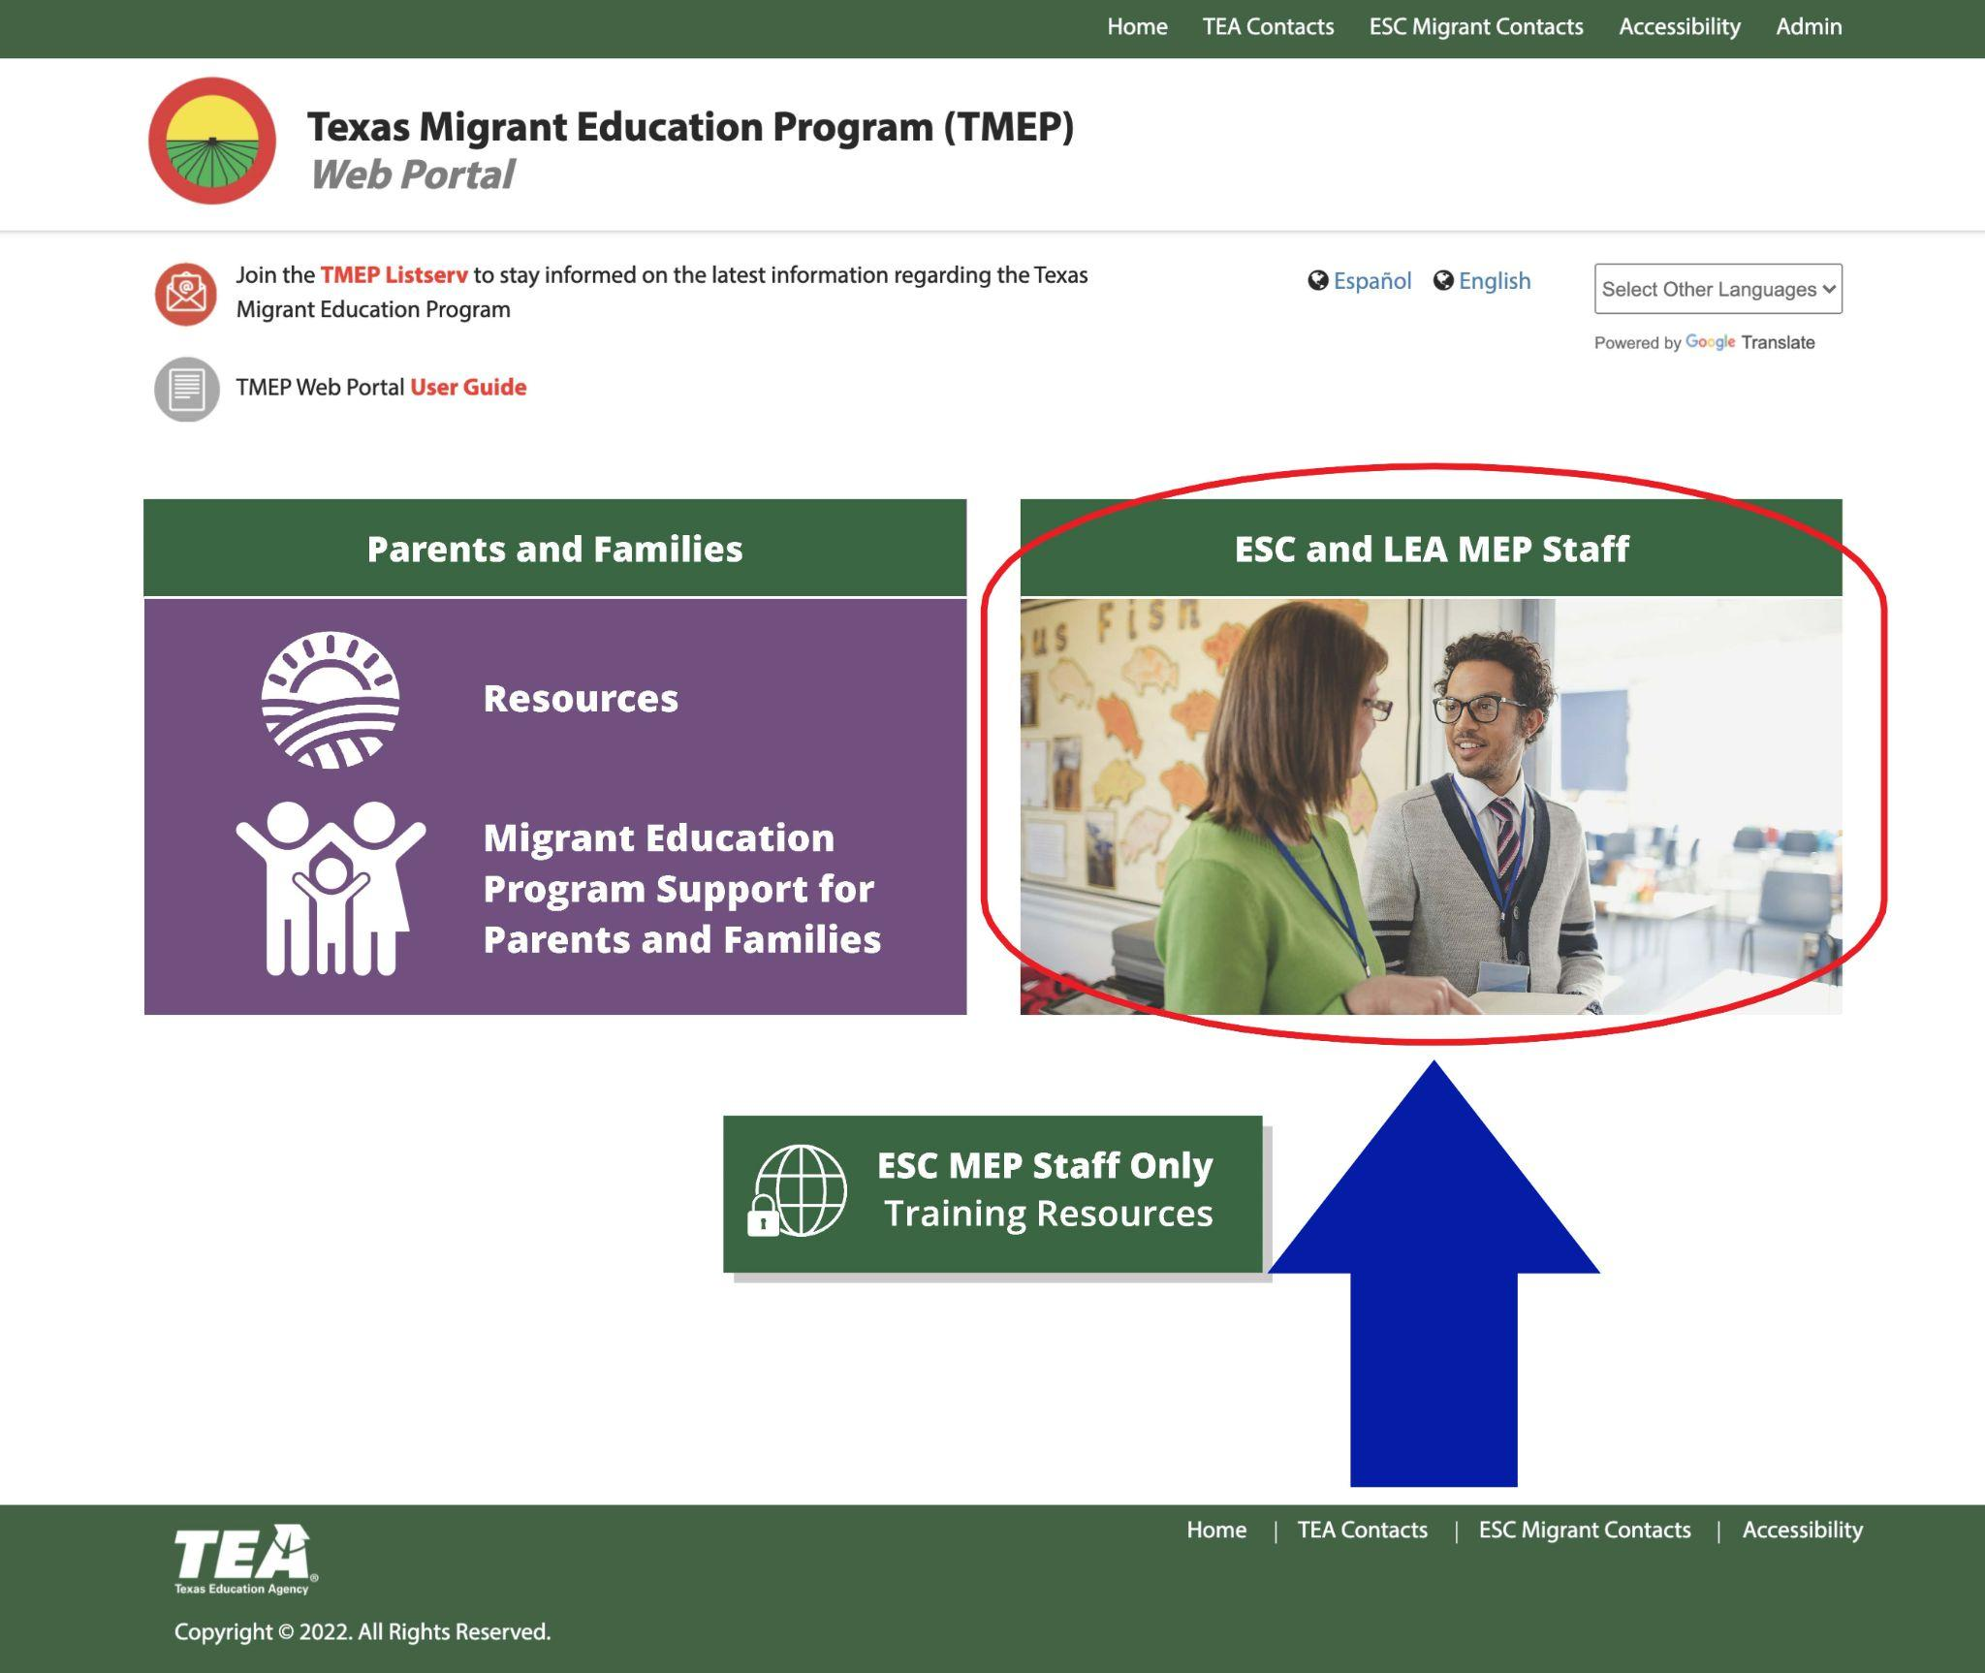
Notes:
Say:
Now let’s take a look at the MEP Staff side of the portal, which you can access by clicking on that image.
https://www.txmigrant.net/
Go to the site and point out:
**The icons that are or will be linked. TIME Permitting, visit each of the icons below:
Go to the PS landing page, login, and provide a brief overview.
Go to the ABB landing page, login, and provide a brief overview. Click on a Tip Sheet, point out a video.
Go to Ed Resources landing page, login review, and provide a brief overview
**Contact Us section: emphasize it is set up just like the parents’ contact us section and encourage all MEP staff to provide feedback
**Frequently Used Resources: Show the list of items linked as of right now and highlight the Migrant Education Marketing Materials page: Point out that this page houses the fully accessible versions of the marketing videos currently available.
Any questions about anything on the MEP Staff side of the portal?
(return to the presentation)

Slide 15
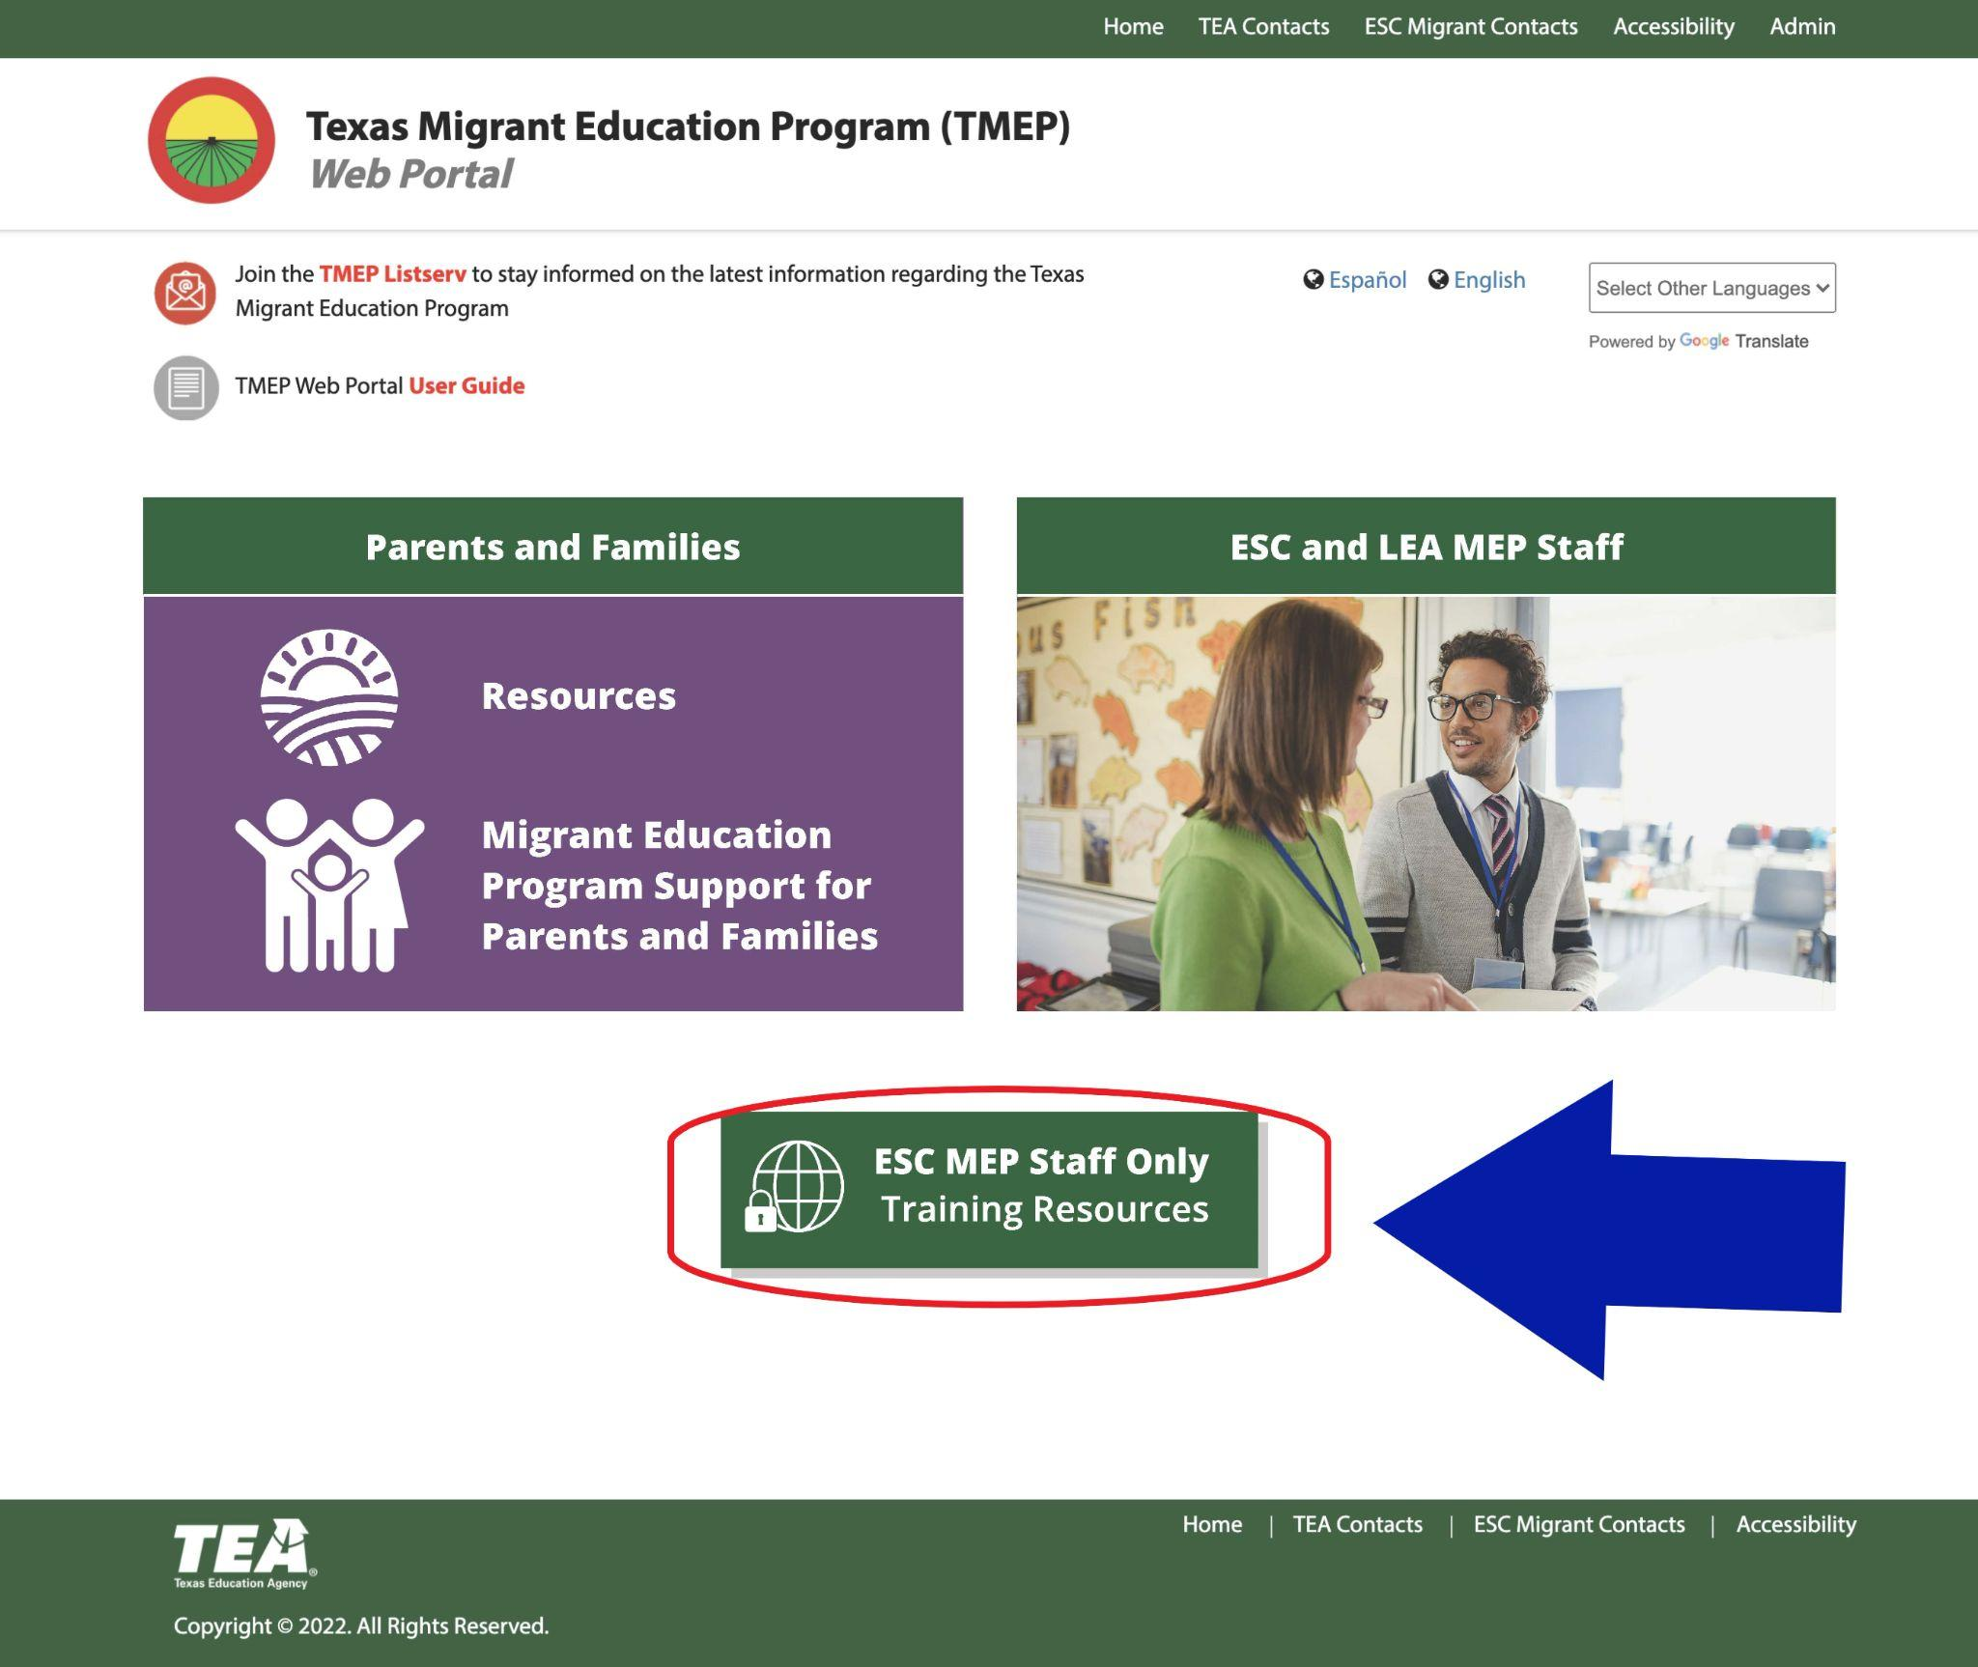
Notes:
Say:
So far everything we have reviewed can be accessed by anyone who visits the web portal.
There is one section of the portal that will be password protected and will only be accessible to ESC MEP staff. It’s the section you see down at bottom of the home page titled ESC MEP Staff Only section.
This section will contain items that are available and accessible to ESC MEP staff only because it will contain training powerpoints and resources from TOTs delivered by the TEA. This section of the portal will not be available to LEA MEP staff or parents.

Slide 16
https://www.txmigrant.net/
Notes:
Say:
That completes our tour of the TMEP portal, does anyone have any questions?
**if many are on devices, pause and give time for them to join the listserv.
We highly recommend you bookmark this site and if you were unable to follow along, we encourage you to please hop on to the site after today’s sessions to sign up for the listserv and do some exploring on your own.

Slide 17
Notes:
Say:
One of the resources that can be accessed from both sides of the TMEP portal is the Education Resources for Parents of K-12 Migratory Children site.
This is linked on the MEP Staff side of the portal and also under the Educational Support tab on the Parents and Families side.

Slide 18
What is this resource?
This resource is a portal with digital resources available for the parents of migratory children.
What is the purpose of this resource?
The purpose of the portal is to provide parents with digital resources to support the unmet educational needs of migratory children.
Notes:
Say:
What is this resource?
This resource is actually a resource portal with digital resources available for the parents of migratory children. In April of 2022, this portal was updated and the process for creating an account and logging in was simplified to make it easier for parents to gain access.
(click)
What is the purpose of the resource?
The purpose of the resource portal is to provide parents with digital resources to support the unmet educational needs of migratory children. At the present time, the resources available support the reading and writing needs of children in grades K-12. Additionally, there are resources and tools linked to support Out-of-School Youth or OSY.

Slide 19
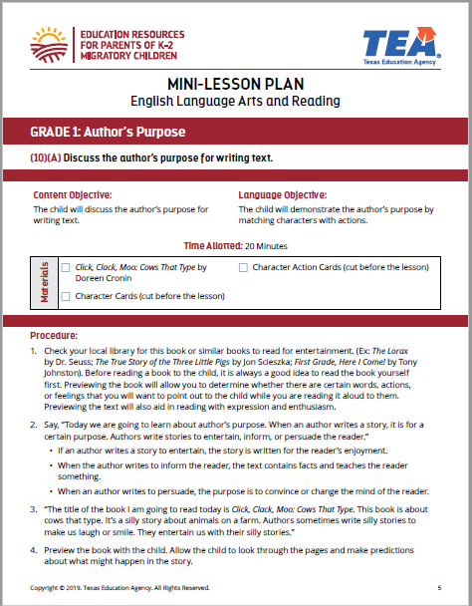
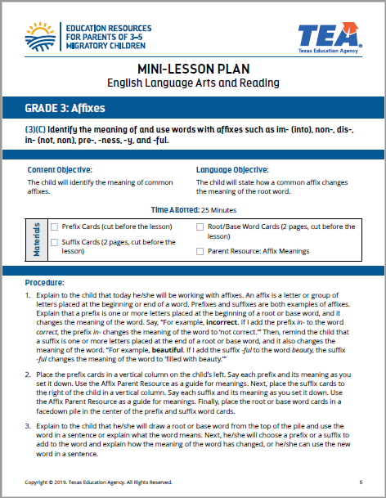
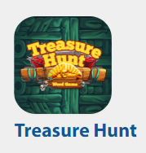
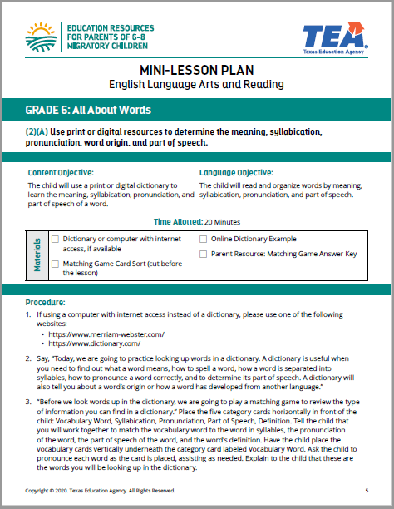
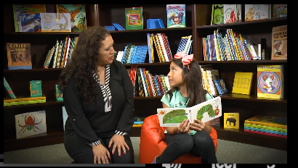
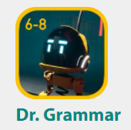
What are the components of this resource?
Tip Sheets with Video Vignettes
Interactive Games/Apps
Mini-Lessons
Notes:
Say: The program is organized by grade bands. (Kinder through 2nd, 3rd - 5th, 6th - 8th, and 9th - 12th)
The format of the resources for grades K-8 is similar.
Each of these grade bands has access to (CLICK) mini-lessons for parents to use at home with their child, (CLICK) tip sheets written for the parents with accompanying video vignettes that show best practices in real-life, and (CLICK) interactive games or apps for children to reinforce grade-appropriate literacy skills while playing games.

Slide 20
What are the components of this resource?
Interactive online course modules
Notes:
Say: The format of the resources for students in grades 9 - 12 differs from those found in K-8. The resources for high school students are intended to be used directly by the students. They consist of interactive online course modules designed to support and review content from English I and ESOL I, and English II and ESOL II, that will be tested on the End of Course (or EOC) exams that all Texas high school students must take.

Slide 21
What are the components of this resource?
Notes:
Say: When parents enter the 9-12 section of the portal, they will have the option to watch a short video that explains how to give their children access to the modules, what to expect, and how they can support their children as they work with the online content.

Slide 22
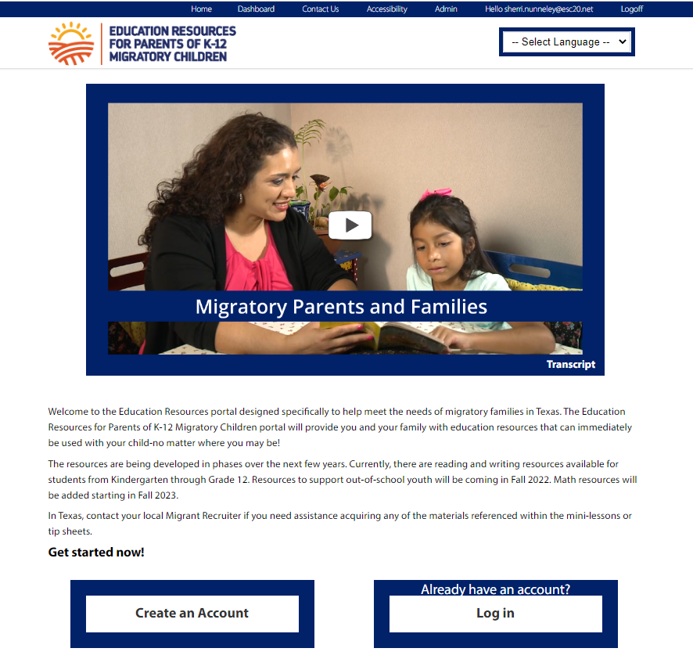
How do parents of migratory children access these resources?
https://www.txmigrantk12.net
Notes:
Say:
What you see here is an image of the current portal home page, along with the web address to the portal at the bottom of the page.
These pages, as well as the login process, have recently been redesigned in an effort to attract and engage more migratory parents and families. The goal is for parents to have easy access to these beneficial resources so the pages have been streamlined and the login process has been simplified. We wanted to remove any barriers that might prevent some migratory families from utilizing these resources.
We are going to give you a quick preview of the resources available and how they are organized.

Slide 23
Notes:
(Home page) This is the current home page of the portal. The video that you see here titled, Migratory Parents and Families welcomes parents and provides a quick overview of all the resources found on the site and explains the simple process for creating an account, how to login, and how to access the resources.
Notice that the page is streamlined to a single column, the toggle button (CLICK) to change languages is accentuated, and there are 2 clear and simple options for getting started: users can create an account (CLICK) or log in if they have already created their account (CLICK).

Slide 24
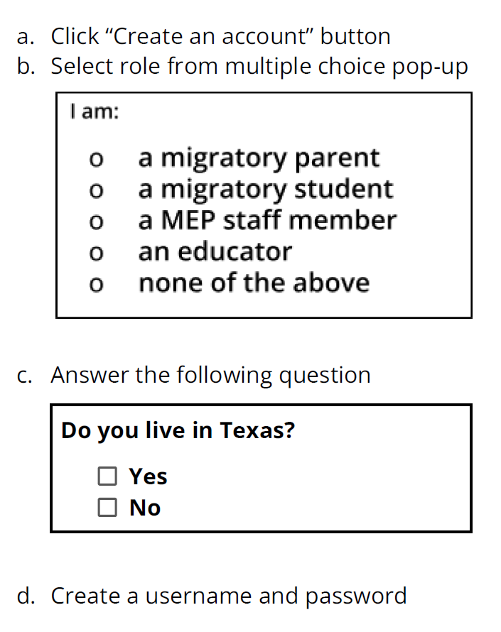
access
New Login Process
Notes:
Say:
The new login process no longer requires an access code or an email address. Users are able to independently create an account by answering a few questions about their role and location. They create a username, password, and select a few security questions to answer. After this process is complete, they have immediate access to the resources.
The questions about role and location will help us track usage by our target audience: migratory families in Texas. While other users are NOT prohibited from creating an account and utilizing the resources, we will continue to focus on increasing the number of registered users who are migratory parents in Texas; that will always remain our goal.
Once an account is created, users are taken to the dashboard page to select a grade band and access the available resources.

Slide 25
dashboard
Notes:
This is the dashboard page where a grade band is selected. As of today there are resources available for children in grades K-12 and out-of-school youth.
Let’s take a look at the resources available now, and discuss future resources for this site.

Slide 26
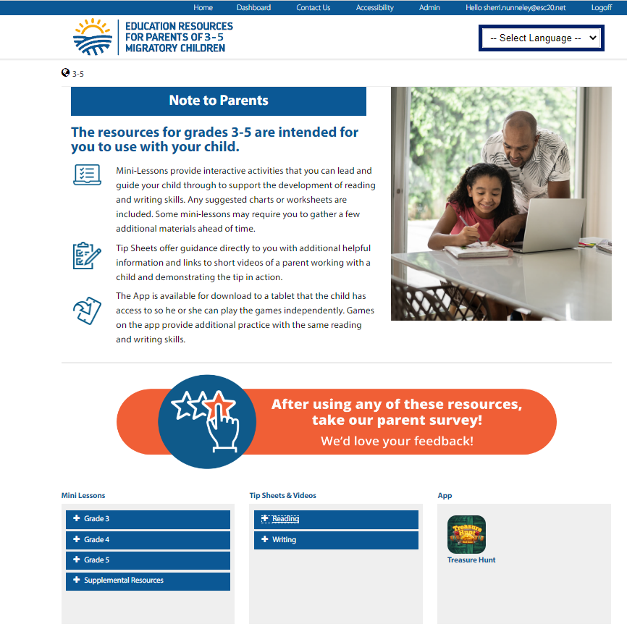
K-8
Notes:
As stated, for grades K-2, 3-5, and 6-8, you can find all available components including Mini-Lessons, Tip Sheets, and the game or app available for that grade band. As mentioned before, the current resources support reading and writing skills.

Slide 27
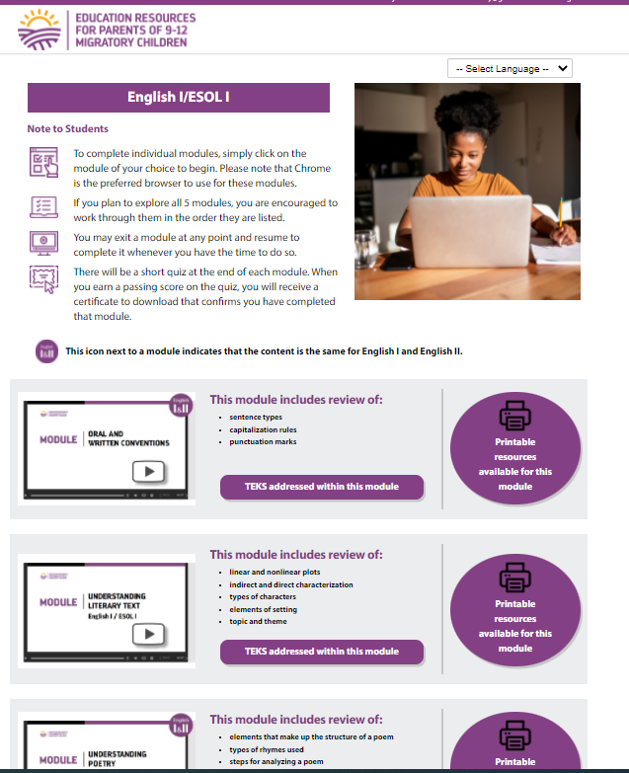
9-12
Notes:
The resources for students in grades 9 - 12 were designed to be used directly by the students. Students at this age engage directly with interactive online modules by selecting the content they would like to review.

Slide 28
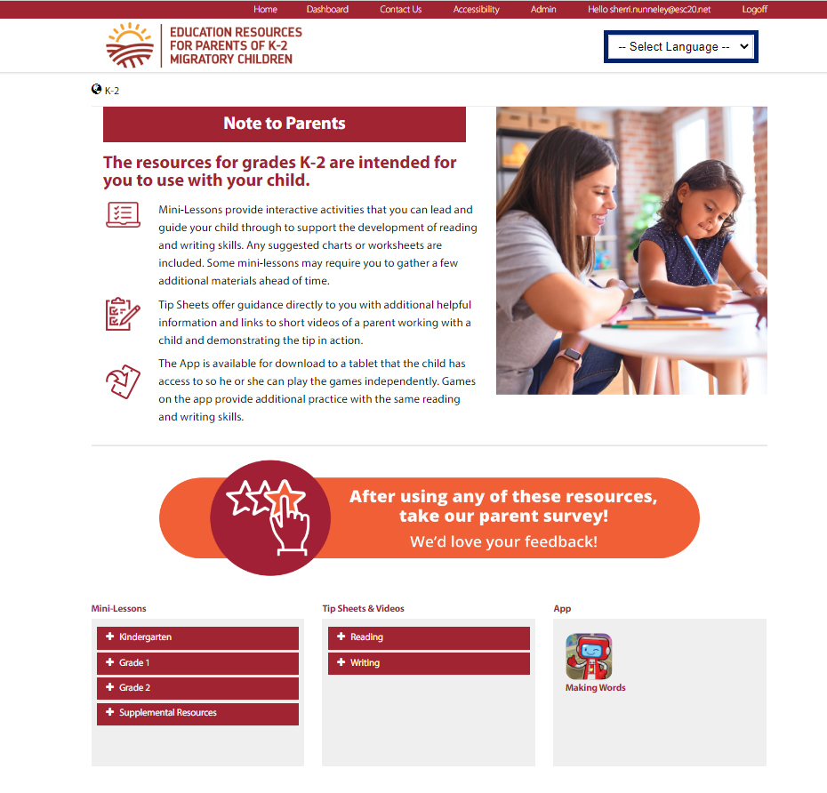
osy
Math Resources for K-2
Coming soon:
Notes:
So what are the future resources coming for this site? For this upcoming year, our plan is to work with the Agency to develop Math resources that parents can use to support their children in Kindergarten through second grade.
(Pause)
Does anyone have any questions regarding the Education Resources for Parents of K-12 Migratory students?

Slide 29
Texas Migrant Education Program Resources for Migratory Children
Marketing Resources
available at
the TMEP Portal
Notes:
If audience consists of MEP staff only:
Say:
Now that we’ve provided you with information about the TMEP portal, Parents and Families sections, and the Education Resources portal for Parents, let’s talk about marketing. One of our challenges has been figuring out the best way to advertise and market these resources so that migratory families across Texas know that they are available; the data we have regarding the use of these resources indicates the need to increase our marketing efforts statewide.
Pause to ask this question and ask for feedback: What marketing and advertising efforts have you found most successful when sharing resources with migratory families?
*Facilitator should jot down any ideas shared.
Thank you for sharing those great ideas. We are always looking for ways to spread the word about these helpful, free resources.
To assist with this, we want to show you the Migrant Education Marketing Materials webpage and where the marketing resources are housed.
Start on TMEP home page, and show that you are clicking on Frequently Used Resources, then Texas Migrant Education Marketing Materials, then brochures.
There are several versions of a Digital Resources brochure that could be printed and given directly to migratory parents and families. They all contain the same information but are in English and Spanish with the options for printing in black and white or color.
Click on the Color English brochure.
As you can see, after printing, these are tri-fold brochures that could be distributed at family nights, parent meetings, or anytime you have opportunities to meet with parents in person.
We have also developed several short videos in both English and Spanish that market the Education Resources portal. Our hope is that ESC and district MEP staff will share links to the videos with their parents.
Here’s an example of the marketing video for the Education Resources portal. (Click to play the English video. Video lasts a minute and a half)
Does anyone have any questions about any of the resources shared?
If audience consists of parents and MEP staff:
Say:
We have provided you with information about the TMEP portal, Parents and Families sections, and the Education Resources portal for Parents. One of our challenges has been figuring out the best way to ensure migratory families across Texas know about these resources; the data we have regarding the use of these resources indicates the need to increase our efforts in sharing these resources statewide.
Pause to ask this question and ask for feedback: What are some of the most successful ways you have found to share resources with migratory families? OR If you are a parent or family member, what are some of the most common ways you learn about new resources?
*Facilitator should jot down any ideas shared.
Thank you for sharing those great ideas. We are always looking for ways to spread the word about these helpful, free resources.
To assist with this, we want to show you the Migrant Education Marketing Materials webpage and where the marketing resources are housed.
There are several versions of a Digital Resources brochure. They all contain the same information but are in English and Spanish with the options for printing in black and white or color. They provide some information about each site shared with you today as well as QR codes that link to each site.
We have also developed several short videos in both English and Spanish that market the Education Resources portal. These videos were designed to be viewed and shared with migratory parents.
Here’s an example of the marketing video for the Education Resources portal. (Click to play the English video. Video lasts a minute and a half)
Does anyone have any questions about any of the resources shared?

Slide 30
Thank You!
Idalia Ibañez
Director – MEP/USCO/Title V, Part A
Federal Program Compliance Division
Texas Education Agency
migrant.ed@tea.texas.gov
Jeremy Poston
Research and Development Specialist
Federal, State, and Local Initiatives
Education Service Center, Region 20
tea.mepgrants@esc20.net
Notes:
Say:
That concludes our session for today. We appreciate the time you have given us to share this information on the programs and resources being developed for migratory children and parents.
We will remain here in our meeting for a few minutes, in case anyone has any questions or comments. Thank you!

